Slide 1
Lesson 2
Making
money
Speaker/team/other
Month 00, 2022

Slide 2
Career planning process
Lesson 2
Making
money
Whether you are seeking your first job, or considering changing to a different field, you must take various actions to obtain a job.
Phase 1: Assess your personal interest, abilities and career goals
Phase 4: Apply for employment positions with the use of a résumé or application letter
Phase 2: Evaluate the current employment market
Phase 5: Interview for available positions
Phase 3: Identify specific job opportunities
Phase 6: Obtain additional career training
Notes:
Review the career planning process. Ask if the students have any questions.
Option: Have students complete activity 2-1 – Assess individual interests, abilities and career goals and complete the worksheet (students can complete individually or incorporate into group discussion) – Slide 3
Option: Have students complete activity 2-2 – Select two career areas that interest the class. Using internet, information from others, obtain answers to the questions on the worksheet. (Choosing two different types of careers would work well for this activity.) – Slide 4
After activities are completed, discuss identifying and applying for employment opportunities. Provide examples for job ads through the internet and job boards, business organizations, networking with personal contacts, and other advertisements.

Slide 3
Preparing for a job interview
Lesson 2
Making
money
1
2
3
Before the interview
During the interview
After the interview
Research the organization.
Practice your interviewing skills.
Prepare questions that you plan to ask.
Prepare proper dress and grooming.
Plan to arrive early at the interview.
Relax. Be yourself.
Answer questions completely and calmly.
Ask questions to help you better know the organization.
Ask when you might hear from the organization.
Write down notes on how you can improve for your next interview.
Promptly send a thank-you letter to the person with whom you interviewed to express your appreciation for the opportunity to meet with them.
Notes:
Review the concept of preparing for a job interview with the students, and post-interview recommended actions.
When preparing for a job interview, take the following actions:
1.When researching an organization, obtain information on:
■What are its main activities?
■What types of jobs does it have?
■What do the people who work there like about their employment situation?
2.Practice your interviewing skills:
■Write out answers to possible interview questions.
■Have someone interview you.
3.Prepare questions that you plan to ask:
■What skills are needed for success in the organization?
■What opportunities are available for continued learning?
Option: Have students complete activity 2-3 – Creating a resume. If there isn’t time to give students time to complete the worksheet, discuss the sections/categories listed on the activity worksheet - Slide 6

Slide 4
Common interview questions
Lesson 2
Making
money
Benefits cost your employer, on average, an extra 33% – 50% of your pay. These may include:
What activities have helped you expand your interests, abilities, and knowledge?
In what types of situations have you done your best work?
Describe the supervisors who motivated you most.
Describe someone with whom you had difficulty working.
What are your major strengths?
What are your weaknesses? What have you done to overcome your weaknesses?
What do you know about our organization?
Who is someone you admire? Why do you admire that person?
4
Notes:
Note to presenter:
Review these sample questions with the students. Provide tips for how to answer some questions, or role play answering a question or two with students.

Slide 5
Adding up the benefits
Lesson 2
Making
money
Benefits cost your employer, on average, an extra 33% – 50% of your pay. These may include:
Health, dental and eye care insurance
Life insurance/ disability insurance
Flexible spending account
Health savings account
Tax-deferred retirement plan
Paid vacation
Paid holidays
Parental leave
Stock purchase plan
Employee assistance plans
Employee fitness programs
Employee discounts
Tuition assistance or reimbursement
Notes:
Review common employee benefits with the students. Ask the students which employee benefits they feel are most important.
While there are many benefit options, make sure to note these potential “hidden” job costs:
Transportation
Clothing (uniform, nice clothing/office attire)
Food
Child/adult care
Union dues

Slide 6
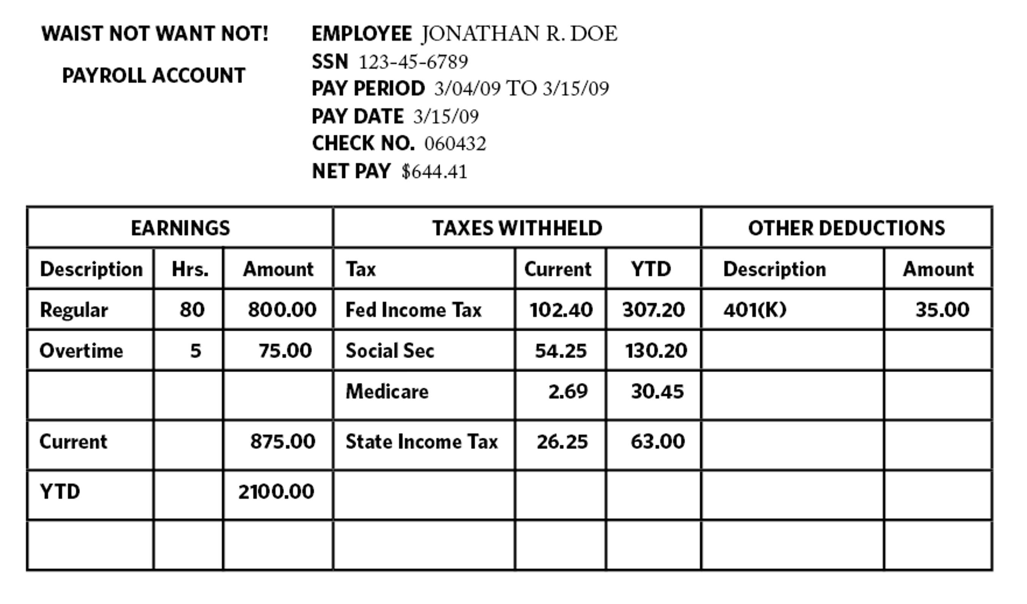
Reading a paystub
Lesson 2
Making
money
Notes:
Review the following and where to find on the pay stub:
Pay period
Gross pay
Wage deductions
Federal income tax
FICA (Social Security and medicare)
Individual state or local income tax
Tax-free or tax-deferred benefits
Net pay

Slide 7
Examples of paycheck deductions
Lesson 2
Making
money
Federal Income Tax
Federal Income Tax is a progressive tax. A progressive tax is a type of tax where the effective tax rate (the tax amount expressed as a percentage) increases as the amount to which the rate is applied (a person’s adjusted income) increases. Every year, the U.S. Federal Government changes the tax rates and income brackets. See the chart below for an example from 2008.
Federal Insurance Compensation Act (FICA), the official name for Social Security and Medicare taxes.
The Social Security tax rate is 6.2% on your gross income, but the amount is limited and you stop paying the tax after you reach a certain income. This limit, known as the Social Security Wage Base, changes each year as economic conditions change.
Currently, the Medicare tax rate is 1.45% on all wages earned with no limit.
Your employer must also pay a separate 6.2% Social Security tax on your behalf and the 1.45% Medicare tax.
Federal income brackets and tax rates
Marginal tax rate | Single | Married filing jointly or qualified widow(er) | Married filing separately | Head of household
10% | $0 – $8,025 | $0 – $16,050 | $0 – $8,025 | $0 – $11,450
15% | $8,026 – $32,550 | $16,051 – $65,100 | $8,026 – $32,550 | $11,451 – $43,650
25% | $32,551 – $78,850 | $65,101 – $131,450 | $32,551 – $65,725 | $43,651 – $112,650
28% | $78,851 – $164,550 | $131,451 – $200,300 | $65,726 – $100,150 | $112,651 – $182,400
33% | $164,551 – $357,700 | $200,301 – $357,700 | $100,151 – $178,850 | $182,401 – $357,700
35% | $357,701+ | $357,701+ | $178,851+ | $357,701+
Notes:
Opportunity to elaborate from slide 6 on Federal income tax, tax brackets and FICA.

Slide 8
Examples of paycheck deductions
Lesson 2
Making
money
State and local income taxes
The tax rate ranges from 0% to close to 10% depending on the state and town in which you live.
Tax-free and tax-deferred benefits
The U.S. federal government provides numerous plans that allow an employee to save for certain life events with pre-tax dollars. These savings plans allow a person to invest in their retirement, health care, childcare, and many other life events and receive a tax reduction or pay no tax at all on the money saved. Health Savings Accounts (HSAs), Flexible Spending Accounts (FSAs), 401(k) retirement plans, and many other “cafeteria plans” are examples of tax-advantaged benefits.
When you sign up for one of these plans, your savings contribution is automatically deducted from your paycheck before your taxes are calculated, which allows you substantial tax savings and will show up as a line item on your pay stub reflecting an adjustment to your taxable income.
Net pay
Your net pay — often called your “take home pay” — is the remaining amount you get to keep after all deductions are removed from your gross (or total) pay.
Notes:
Opportunity to elaborate from slide 6 on Federal income tax, tax brackets and FICA.

Slide 9
Lesson 2
Making
money
Lesson 2 quiz

Slide 10
Lesson 2 quiz
Lesson 2
Making
money
True/False
1. |  | The career planning process starts with assessing your personal interests, abilities, and goals.
2. |  | Interviewing is the final phase of the career planning process.
3. |  | Travel costs to work are considered to be “hidden” job costs.
4. |  | Worker’s compensation is a common employee benefit received by most workers.
5. |  | Gross pay results from deducting various deductions from your earnings.
F
F
T
T
F
Multiple choice
6. |  | The first phase of the career planning process is to:
 |  | A. Identify specific job opportunities B. Interview for available positions C. Assess personal interests and abilities D. Apply for employment positions
7. |  | After applying for an available position, the next step usually involves:
 |  | A. Interviewing B. Obtaining training for necessary job skills C. Comparing employee benefits D. Preparing a resume
C
A
Notes:
If there is time, allow students to complete the quiz, then review the answers with them. Answers are featured in slide slow mode with each click.

Slide 11
Lesson 2 quiz
Lesson 2
Making
money
Multiple choice
8. |  | A hidden cost of a job might involve:
 |  | A. Gross pay B. Uniform fees C. Employee discounts D. Retirement benefits
9. |  | Which of the following employee benefits would a working parent find most useful?
 |  | A. Stock options B. Tax deferred retirement plan C. Social Security benefits D. Parental leave
B
D
10. |  | A common deduction on a person’s pay stub would be:
 |  | A. Gross pay B. Unemployment tax C. Federal income tax D. Excise tax
C

Slide 12
Lesson 2 quiz
Lesson 2
Making
money
Divide into multiple teams. Each team will designate someone who will be the interviewer and someone who will be the interviewee. The interviewer will have 3 minutes to prepare a list of five questions to ask and in turn, the interviewee will have 3 minutes to prepare a list of five questions to ask the interviewer.
The name of the company is ABC High School in Anytown, U.S.A. The position is of a guidance counselor. At the conclusion of the interview, each team will openly discuss whether the interview went well and why or if it didn’t go well, and why.
Group activity
Notes:
Optional group activity if time allows

Slide 13
Important information
Equitable is the brand name of the retirement and protection subsidiaries of Equitable Holdings, Inc., including Equitable Financial Life Insurance Company (Equitable Financial) (NY, NY); Equitable Financial Life Insurance Company of America (Equitable America), an AZ stock company; and Equitable Distributors, LLC. The obligations of Equitable Financial and Equitable America are backed solely by their claims-paying abilities. Equitable Advisors is the brand name of Equitable Advisors, LLC.
© 2022 Equitable Holdings, Inc. All rights reserved. GE-4907264.1 (8/22) (Exp. 8/24) | G1849505 | Cat. #164714 (9/22)

Slide 15
Thank you.

