Slide 1
Lesson 8
Saving and
investing
Speaker/team/other
Month 00, 2023
Notes:
Note to speaker: introduce yourself and the lesson
Saving and investing are cornerstones of financial management. To be effective money managers, students need to: establish and maintain a budget; set clear,
specific financial goals; and understand all of their investment options.
Lesson Goals:
Introduce the advantages and disadvantages of common savings and investment vehicles and show the short- and long-term effects of various savings and investment choices.

Slide 2
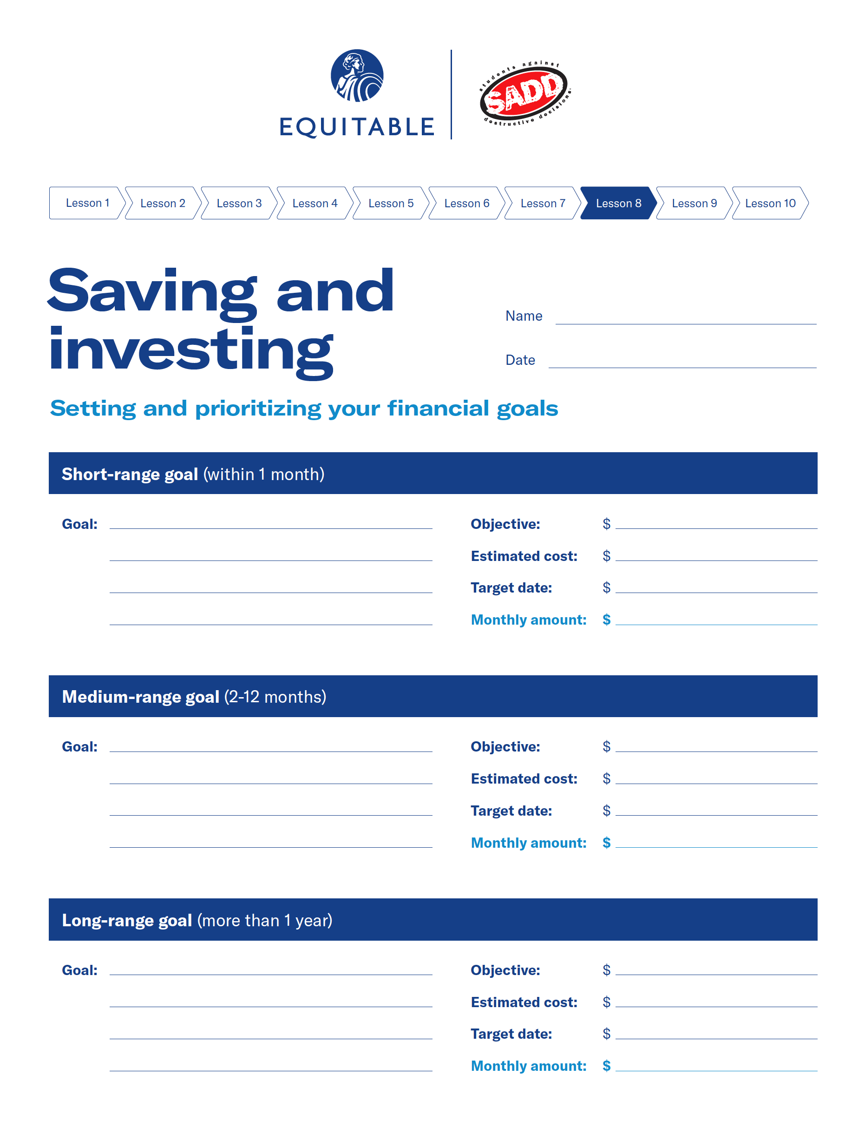
Saving and investing — lesson 8 exercise
Lesson 8
Saving and
investing
Option 1
activity
Depending on how much time there is to complete the lesson, you may select one of the following worksheet exercises for the students to complete.
Worksheet 8-1: Complete this worksheet and prioritize your financial goals using your own income or a theoretical income. Plan to share some of your goals with the group for discussion.
Notes:
Notes to presenter:
Setting and Prioritizing Your Financial Goals
■ Have students complete the “Setting Financial Goals” worksheet. If your students
don’t have enough income to complete this exercise, give them a theoretical income to
work with.
■ Ask students to share some of their goals with the class, including estimated cost,
target date, and the amount they would need to save each week to meet their goal.
■ Discuss and reemphasize the importance of goal setting and planning.
■ Have students prioritize the goals they identified.
Discussion points to consider:
set financial goals
1. Why save?
■ To reach financial goals
■ In case of an emergency
■ To have the option of taking advantage of
unforeseen opportunities
2. Why set goals?
■ Give direction for making plans and taking actions
3. Set and prioritize your financial goals
■ The goal-setting process
■ Short-term goals (1–4 weeks)
■ Medium-term goals (2–12 months)
■ Long-range goals (1 year or longer)

Slide 3
Pay yourself first
A little can add up!
Lesson 8
Saving and
investing
Save this each week | At % interest | In 10 years you’ll have
$7 | 5% | $4,720
$14 | 5% | $9,440
$21 | 5% | $14,160
$28 | 5% | $18,880
$35 | 5% | $23,600
You can buy: two fast food meals or one movie ticket (and a candy bar) or save $7 this week.
You can buy: two small cheese pizzas or one large pepperoni pizza, delivered, or one new CD or save $14 this week.
What can you give up to save for your financial goals?
Notes:
pay yourself first
1. Why?
■ To make a habit of saving money to reach your
financial goals
2. What it takes
■ Commitment
■ Discipline
■ Delayed gratification
3. Ways to do it
■ From each paycheck or allowance, deposit a set
amount or percentage into your savings account
before spending money on anything else.
■ At the end of the day, put all your change in a
“savings” container. Once a month, deposit the
money in a savings account.
■ Whenever you get unexpected money, put a
portion of it into savings.
4. Remember
■ Amount saved isn’t as important as getting into
the habit.

Slide 4
Lesson 8
Types of savings accounts
Saving and
investing
Passbook account
Statement account
Interest-earning checking account
Depositor receives a booklet in which deposits, withdrawals and interest are recorded.
Average interest rate is lower at banks and savings and loans than at credit unions.
Funds are easily accessible.
Basically the same as a passbook account, except depositor receives monthly statements instead of a passbook.
Accounts are usually accessible through 24-hour automated teller machines (ATMs).
Interest rates are the same as passbook account.
Funds are easily accessible.
Combines benefits of checking and savings.
Depositor earns interest on any unused money in their account.
Notes:
Review the types of savings accounts
Cover the advantages – simplest way to earn while keeping money readily available
Passbook and statement accounts

Slide 5
Lesson 8
Certificates of Deposit (CDs)
Saving and
investing
What they are and how they work
Bank pays a fixed amount of interest for a fixed amount of money during a fixed amount of time.
Benefits
Trade-offs
Types of certificates of deposit
No risk
Simple
No fees
Offers higher interest rates than savings accounts.
Restricted access to your money
Withdrawal penalty if cashed before expiration date (penalty might be higher than the interest earned)
Rising-rate CDs with higher rates at various intervals, such as every 6 months
Stock-indexed CDs with earnings based on the stock market
Callable CDs with higher rates and long-term maturities, as high as 10-15 years; however, the bank may “call” the account after a stipulated period, such as 1 or 2 years, if interest rates drop
Global CDs combine higher interest with a hedge on future changes in the dollar compared to other currencies
Promotional CDs attempt to attract savers with gifts or special rates
Notes:
Review and discuss other saving methods:
Money-market deposit accounts
Certificates of deposit (CD’s)

Slide 6
Lesson 8
How interest is calculated
Saving and
investing
Simple interest calculation
Compound interest calculation
Interest is paid on original amount of deposit, plus any interest earned.
Dollar amount x interest rate x length of time (in years) = amount earned example
(Original $ amount + earned interest) x interest rate x length of time = amount earned example
If you had $100 in a savings account that paid 6% simple interest during the first year you would earn $6 in interest.
If you had $100 in a savings account that paid 6% interest compounded annually, the first year you would earn $6 in interest.
$100 x 0.06 x 1 = $6 $100 + $6 = $106
$100 x 0.06 x 1 = $6
At the end of 2 years, you would have earned $12.
The account would continue to grow at a rate of $6 per year, despite the accumulated interest.
With compound interest, the second year you would earn $6.36 in interest. The calculation the second year would look like this:
$106 x 0.06 x 1 = $6.36 $106 + $6.36 = $112.36
Notes:
Review and discuss how to calculate interest
Simple
Compound
Option to complete worksheet activity 8-2

Slide 7
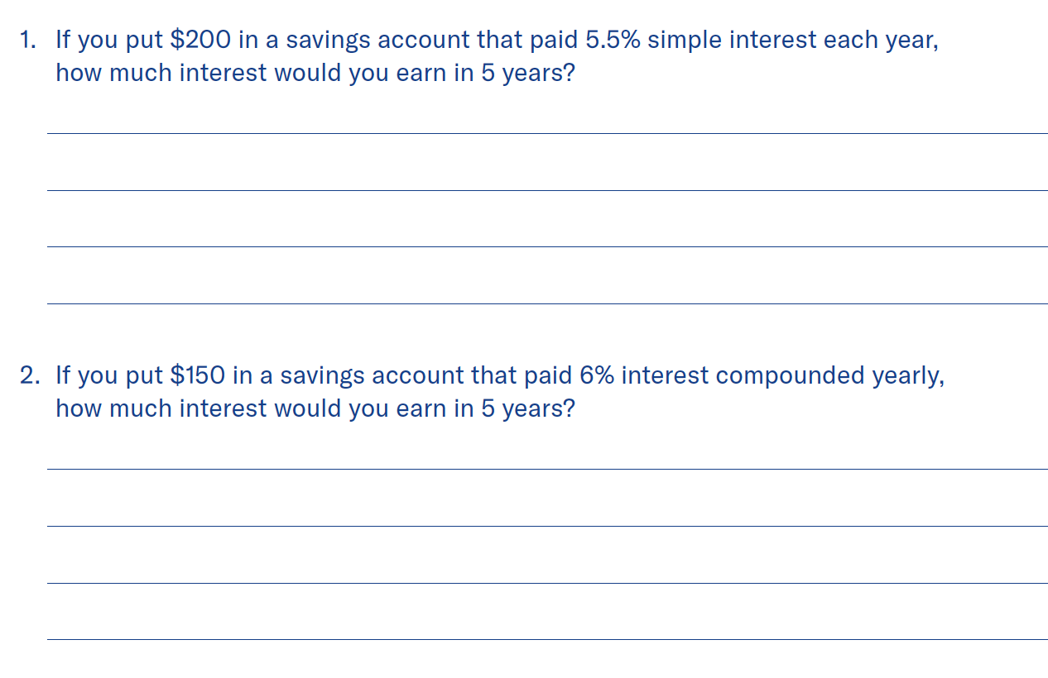
Saving and investing — lesson 8 exercise
Lesson 8
Saving and
investing
Option 2
activity
Depending on how much time there is to complete the lesson, you may select one of the following worksheet exercises for the students to complete.
Worksheet 8-2: Write the answers to the following questions in the blanks provided. Use the space below each problem to show how you arrived at your answers.
$55
$200 x 0.055= $11
$11 x 5 = $55
$50.73
$150 x 1.06 = $159 (after 1 year)
$159 x 1.06 = $168.54 (after 2 years)
$168.54 x 1.06 = $178.65 (after 3 years)
$178.65 x 1.06 = $189.37 (after 4 years)
$189.37 x 1.06 = $200.73 (after 5 years)
Notes:
Notes to presenter:
Calculating Interest
■ Have students complete the “Calculating Interest” worksheet.
■ Review the answers and as needed, show the calculations on the board.
■ Reemphasize how the interest rate and the method of calculation can affect how much
their money grows.
■ Have students visit practicalmoneyskills.com/calculators for online help.

Slide 8
Lesson 8
Saving and investing — lesson 8 exercise (cont.)
Saving and
investing
Worksheet 8-2: calculating interest
 | Amount of deposit | Interest rate | Months on deposit | Periods/year | Interest
Start of year 1 | 25 | 0.065 | 12 | 12 | 1.63
 | 25 | 0.065 | 11 | 12 | 1.49
 | 25 | 0.065 | 10 | 12 | 1.35
 | 25 | 0.065 | 9 | 12 | 1.22
 | 25 | 0.065 | 8 | 12 | 1.08
 | 25 | 0.065 | 7 | 12 | 0.95
 | 25 | 0.065 | 6 | 12 | 0.81
 | 25 | 0.065 | 5 | 12 | 0.68
 | 25 | 0.065 | 4 | 12 | 0.54
 | 25 | 0.065 | 3 | 12 | 0.41
 | 25 | 0.065 | 2 | 12 | 0.27
 | 25 | 0.065 | 1 | 12 | 0.14
End of year 1 | 300
$639.00
Start of year 2 | 325 | 0.065 | 12 | 12 | 19.50
 | 25 | 0.065 | 11 | 12 | 1.49
 | 25 | 0.065 | 10 | 12 | 1.35
 | 25 | 0.065 | 9 | 12 | 1.22
 | 25 | 0.065 | 8 | 12 | 1.08
 | 25 | 0.065 | 7 | 12 | 0.95
 | 25 | 0.065 | 6 | 12 | 0.81
 | 25 | 0.065 | 5 | 12 | 0.68
 | 25 | 0.065 | 4 | 12 | 0.54
 | 25 | 0.065 | 3 | 12 | 0.41
 | 25 | 0.065 | 2 | 12 | 0.27
 | 25 | 0.065 | 1 | 12 | 0.14
End of year 2 | 600
Notes:
Notes to presenter:
Calculating Interest
■ Have students complete the “Calculating Interest” worksheet.
■ Review the answers and as needed, show the calculations on the board.
■ Reemphasize how the interest rate and the method of calculation can affect how much
their money grows.
■ Have students visit practicalmoneyskills.com/calculators for online help.

Slide 9
Lesson 8
Saving and investing — lesson 8 exercise (cont.)
Saving and
investing
Worksheet 8-2: calculating interest
$1,754.80
Notes:
Notes to presenter:
Calculating Interest
■ Have students complete the “Calculating Interest” worksheet.
■ Review the answers and as needed, show the calculations on the board.
■ Reemphasize how the interest rate and the method of calculation can affect how much
their money grows.
■ Have students visit practicalmoneyskills.com/calculators for online help.

Slide 10
Lesson 8
Choosing a savings account
Saving and
investing
Factors that determine the dollar yield on an account
The following factors reduce money earned and can even turn it into a loss:
Interest rate (also called rate of return or annual yield):
All money earned comes from this factor.
Fees, charges and penalties:
Usually based on minimum balance requirements or transaction fees.
Balance requirements:
Some accounts require a certain balance before paying any interest.
On money market accounts, most banks will pay different interest rates for different size balances (higher balance earns a higher rate).
Balance calculation method:
Most calculate daily. Some use average of all daily balances.
Notes:
Discuss concept of choosing a savings account
Facts to consider
Interest rate
Fees, charges, penalties
Balance requirement
Balance calculation method
2. Truth in savings law

Slide 11
Lesson 8
The rule of 72
Saving and
investing
How many years will it take to double my money?
At what interest rate will my money double in a set number of years?
72 divided by interest rate
72 divided by years to double investment
Year to double a sum of money
Interest rate required
Notes:
about the rule of 72
1. What it is
■ A simple way to estimate how money can grow
■ Divide 72 by the interest rate to find how many
years you need for your money to double.
■ Divide 72 by a number of years to determine the
interest rate needed to double your money in that
period of time.

Slide 12
Lesson 8
Bonds
Saving and
investing
What they are
How they work
Types
A bond is an IOU, certifying that you loaned money to a government or corporation and outlining the terms of repayment.
Buyer may purchase bond at a discount. The bond has a fixed interest rate for a fixed period of time. When the time is up, the bond is said to have matured and the buyer may redeem the bond for the full face value.
Corporate
Sold by private companies to raise money.
If company goes bankrupt, bondholders have first claim to the assets, before stockholders.
Municipal
Issued by any non-federal government.
Interest paid comes from taxes or revenues from special projects. Earned interest is exempt from federal income tax.
Federal government
The safest investment you can make. Even if the U.S. government goes bankrupt, it is obligated to repay bonds.
Notes:
Discuss saving vs. investing to transition into investment vehicles discussion
saving vs. investing
1. Difference
■ Degree of risk
■ Rate and stability of return
■ Availability of funds for use
■ Amount of protection against inflation
Discuss the following about Bonds:
What is a Bond?
How it works?
Types
Advantages

Slide 13
Lesson 8
Mutual funds
Saving and
investing
What they are
Advantages
Types
Professionally managed portfolios made up of stocks, bonds and other investments.
Allows small investors to take advantage of professional account management and diversification normally only available to large investors.
Balanced fund includes a variety of stocks and bonds
Global bond fund has corporate bonds of companies from around the world
Global stock fund has stocks from companies in many parts of the world
Growth fund emphasizes companies expected to increase in value; also has higher risk
Income fund features stocks and bonds with high dividends and interest
Industry fund invests in stocks of companies in a single industry (such as technology, healthcare, banking)
Municipal bond fund features debt instruments of state and local governments
Regional stock fund involves stocks of companies from one geographic region of the world (such as Asia or Latin America)
How they work
Individuals pool their money together and the fund uses it to invest in stocks, bonds and other investments
Profits returned to shareholders monthly, quarterly or semiannually in the form of dividends
Notes:
Discuss the following about mutual funds:
What is a mutual fund?
How it works?
Types
Advantages

Slide 14
Lesson 8
Stocks
Saving and
investing
What they are
How earnings are made
Advantages
Stock represents ownership of a corporation. Stockholders own a share of the company and are entitled to a share of the profits, as well as a vote in how the company is run.
Company profits may be divided among shareholders in the form of dividends. Dividends are usually paid quarterly
Larger profits can be made through an increase in the value of the stock on the open market
If the market value goes up, the gain can be considerable
Money is easily accessible
Disadvantages
If market value goes down, the loss can be considerable
Selecting and managing stock often requires study and the help of a good brokerage firm
Notes:
Discuss the following about Stocks:
Definition
How it works?
Types
Advantages

Slide 15
Lesson 8
Real estate
Saving and
investing
Ways to invest
Advantages
Capital gains
Buy a house, live in it and sell it later at a profit
Buy income property (such as an apartment house or a commercial building) and rent it
Buy land and hold it until it rises in value
Excellent protection against inflation
Profits from the sale of a capital asset, such as stocks, bonds or real estate. These profits are tax-deferred; you do not have to pay the tax on these profits until the asset is sold. Long-term capital gains occur on investments held more than 12 months. Short-term capital gains occur on investments held less than 12 months.
Disadvantages
Can be difficult to convert into cash
A specialized type of investment requiring study and knowledge of business
Notes:
Discuss the following about real estate:
Definition
How it works?
Types
Advantages

Slide 16
Lesson 8
Retirement plans
Saving and
investing
What they are and how they work
Plans that help individuals set aside money to be used after they retire
Federal income tax not immediately due on money put into a retirement account or on the interest it makes
Income tax paid when money is withdrawn
Penalty charges apply if money is withdrawn before retirement age except under certain circumstances
Income after retirement is usually lower, so tax rate is lower
Types
Individual Retirement Account (IRA)
Allows a person to contribute up to $5,000 of pretax earnings per year. Contributions can be made in installments or in a lump sum.
Roth IRA (also called the IRA Plus)
While the $5,000 annual contribution to this plan is not tax-deductible, the earnings on the account are tax-free after 5 years. The funds from the Roth IRA may be withdrawn after age 59½, if the account owner is disabled, for educational expenses or for the purchase of a first home.
401(k)
Allows a person to contribute to a savings plan from their pretax earnings, reducing the amount of tax that must be paid. Employer matches contributions up to a certain level.
Keogh plan
Allows a self-employed person to set aside up to 15% of income (but not more than $35,000 per year).
Notes:
Discuss the following about retirement plans:
Definition
How it works?
Types
Advantages

Slide 17
Saving and investing — lesson 8 exercise
Lesson 8
Saving and
investing
Option 3
activity
Depending on how much time there is to complete the lesson, you may select one of the following worksheet exercises for the students to complete.
Worksheet 8-3: For each of the investment situations below, select the type of mutual fund most appropriate from the list provided.
Global bond fund
Municipal bond fund
Industry fund
Global stock fund
Growth fund
Notes:
Notes to presenter:
Selecting Mutual Funds
■ Review types of mutual funds.
■ Have students complete this exercise.
■ Ask students to explain their answers.
*Answers appear with 1 click

Slide 18
Saving and investing — lesson 8 exercise (cont.)
Lesson 8
Saving and
investing
Option 3
activity
Depending on how much time there is to complete the lesson, you may select one of the following worksheet exercises for the students to complete.
Worksheet 8-3: For each of the investment situations below, select the type of mutual fund that would be most appropriate from the list provided.
Regional stock fund
Income fund
Balanced fund
Municipal bond fund
Regional stock fund
Notes:
Notes to presenter:
Selecting Mutual Funds
■ Review types of mutual funds.
■ Have students complete this exercise.
■ Ask students to explain their answers.
*Answers appear with 1 click

Slide 19
Depending on how much time there is to complete the lesson, you may select one of the following worksheet exercises for the students to complete.
Option 4 activity
Saving and investing — lesson 8 exercise (cont.)
Lesson 8
Saving and
investing
Option 4
activity
Depending on how much time there is to complete the lesson, you may select one of the following worksheet exercises for the students to complete.
Worksheet 8-4: Test your knowledge
Complete the worksheet to test your knowledge of saving and investing based on today’s discussion.
E
1. How long would it take to double your money in an account that paid 6% per year?
2. What interest rate would double your money in 5 years?
72/6 = 12 years
C
72/5 = 14.4%
E
Notes:
Notes to presenter:
Test Your Knowledge of Saving and Investing
■ Have students complete this exercise.
■ Discuss their answers.
*Answers appear with 1 click

Slide 20
Saving and investing — lesson 8 exercise (cont.)
Lesson 8
Saving and
investing
Worksheet 8-4: Test your knowledge
Complete the worksheet to test your knowledge of saving and investing based on today’s discussion.
D
D
E
D
A
C
E
E
B
Notes:
Notes to presenter:
Test Your Knowledge of Saving and Investing
■ Have students complete this exercise.
■ Discuss their answers.
*Answers appear with 1 click

Slide 21
Lesson 8
Saving and
investing
Lesson 8 quiz

Slide 22
Lesson 8
Lesson 8 quiz
Saving and
investing
T
F
T
F
T
Notes:
If there is time, allow students to complete the quiz, then review the answers with them. Answers are featured in slide slow mode with each click.

Slide 23
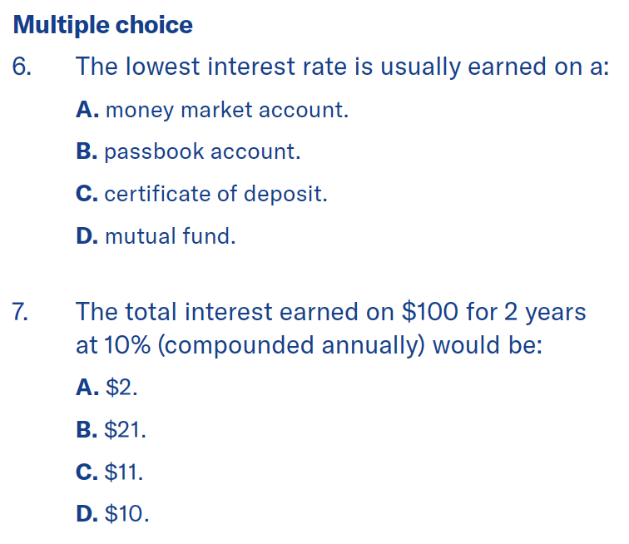
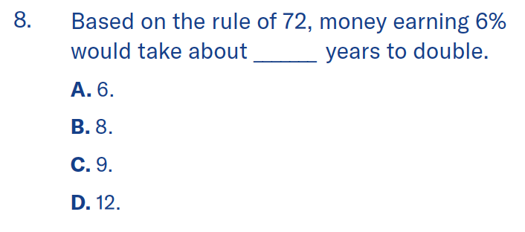
Lesson 8
Lesson 8 quiz
Saving and
investing
D
B
B
B
C
Notes:
If there is time, allow students to complete the quiz, then review the answers with them. Answers are featured in slide slow mode with each click.

Slide 24
Lesson 8
Lesson 7 quiz
Saving and
investing
Common investment goals in this situation might be to create an emergency fund to save for the children's college education and save for retirement. The Johnsons might start their saving-investing program with a savings account, money market account or certificates of deposit. Next, they might consider an aggressive stock mutual fund that could give them good long-term growth for the education and retirement funds. All of those are easier to implement with an automatic withdrawal each month from a bank account to the savings account or investment company.
Notes:
If there is time, allow students to complete the quiz, then review the answers with them. Answers are featured in slide slow mode with each click.

Slide 25
Important information
Equitable is proud to partner with SADD for this initiative to promote financial literacy with teachers and students, and instill ways to achieve solid financial futures.
Please be advised this presentation is not intended as legal or tax advice. Accordingly, any tax information provided in this document is not intended or written to be used, and cannot be used, by any taxpayer for the purpose of avoiding penalties that may be imposed on the taxpayer. The tax information was written to support the promotion or marketing of the transaction(s) or matter(s) addressed, and you should seek advice based on your particular circumstances from an independent tax advisor. Equitable Holdings, Inc. and all of its subsidiaries do not offer bank checking and savings accounts, real estate and/or accounting services.
Equitable is the brand name of the retirement and protection subsidiaries of Equitable Holdings, Inc., including Equitable Financial Life Insurance Company (NY, NY); Equitable Financial Life Insurance Company of America, an AZ stock company; and Equitable Distributors, LLC. Equitable Advisors is the brand name of Equitable Advisors, LLC (member FINRA, SIPC) (Equitable Financial Advisors in MI & TN). The obligations of Equitable Financial and Equitable America are backed solely by their claims-paying abilities.
© 2023 Equitable Holdings, Inc. All rights reserved. GE-5492629.1 (3/23) (Exp. 3/25) | G2090433 | Cat. #162165 (3/23)

Slide 27
Thank you.
Notes:
Read Slide

