Slide 1
Credit cards
Lesson 6
Speaker/team/other
Month 00, 2023
Notes:
Note to speaker: introduce yourself and the lesson
Before students use credit cards, it’s important that they familiarize themselves with:
The advantages and disadvantages of credit cards
Card options and percentage rates
The true cost of credit
Goal for this lesson:
- Develop skills to compare and evaluate the terms and conditions of various credit cards, the differences between credit cards, and the legal and financial responsibilities involved.

Slide 2
Applying for a credit card
Lesson 6
Credit cards
Cost
Annual Percentage Rate (APR)
Grace period
Annual fees
Transaction fees
Balancing computation method for the finance charge
Features
Credit limit
How widely the card is accepted
What services and features are available
Notes:
Discuss the following concepts:
types of credit card accounts
1. Bank card
■ Examples (Visa, MasterCard)
■ Best use of
■ Sample cost/method of payment
2. Store card
■ Examples (Macy's, Chevron)
■ Best use of
■ Sample cost/method of payment
3. Travel and entertainment card
■ Examples (American Express)
■ Best use of
■ Sample cost/method of payment
shopping for a credit card
1. Determining the best use of a card as a personal money
management device
■ Pay bill in full each month and avoid
interest charges
■ Repay bill over time and pay interest charges
2. Costs and features of credit cards
■ Annual Percentage Rate (APR)
■ Grace period
■ Annual fee
■ Late payment fee
■ Over-limit fee
■ Balancing computation method for finance charge
■ Credit limit
■ How widely card is accepted
■ What services and features are available

Slide 3
Calculating finance charges
Lesson 6
Credit cards
1
2
3
4
Average daily balance:
You pay interest on the average balance owed during the billing cycle. The creditor figures the balance in your account on each day of the billing cycle, then adds together these amounts and divides by the number of days in the billing cycle.
Adjusted balance:
You pay interest on the opening balance after subtracting the payment or returns made during the month.
Previous balance:
You pay interest on the opening balance, regardless of payments made during the month.
Past-due balance:
No finance charge is added if the full payment is received within the grace period. If it is not received, a finance charge for the unpaid amount is added on to your next bill.
Notes:
Review the following concepts:
Calculating finance charges (APR)
■ Average daily balance
■ Adjusted balance
■ Previous balance
■ Past due balance
■ Examples

Slide 4
Example of finance charges
Lesson 6
Credit cards
 | Average daily balance | Adjusted balance | Previous balance
Monthly | 1.5% | 1.5% | 1.5%
Rates | 18% | 18% | 18%
Previous balance | $400 | $400 | $400
Payments | $300 | $300 | $300
On 15th day (new balance = $100)
Average daily balance | $250* | N/A | N/A
Finance charge | $3.75 (1.5% x $250) | $1.50 (1.5% x $100) | $6.00 (1.5% x $400)
*To figure average daily balance:
($400 x 15 days) + ($100 x 15 days) = $250 x 30 days
Notes:
Continue discussion from previous slides by reviewing these examples of finance charges

Slide 5
Comparing credit cards
Lesson 6
Credit cards
Type of account
Annual fee
Grace period
Annual Percentage Rate (APR)
Credit limit
Minimum monthly payment
Finance charge calculation method
Late payment fee and other fees
Other features
Notes:
Review the following concepts:
Comparing the costs and features of credit cards
Reading a credit application
■ Interpreting features and costs
■ Examples
2. Before signing
■ Know the details of the contract
■ Ask, if you are not sure
3. Shopping for a credit card
■ Compare costs and features
■ What did you find?

Slide 6
Lesson 6
Making decisions —
lesson 6 exercise
Credit cards
Worksheet 6-1: shopping for credit
Credit card costs and features can vary greatly. This exercise will give you a chance to shop for and compare the costs and features of three credit cards.
Using the attached form and research the costs and features of:
Two major credit cards
One department store credit card
When you’re done, answer the questions on the worksheet.
Notes:
**Depending on how much time there is to complete the lesson, you may complete this activity as a class, have students complete individually, or skip.
Notes to presenter:
■ Discuss how costs and features can vary between credit cards, and have students
apply their findings by making a decision about which kind of card they would use
to purchase a popular electronic device.
■ Using the form provided, ask teams of students to shop for three credit cards (two
major credit cards and one from a local department store). When they’ve finished
their research, ask them to answer a series of questions about their findings.
■ When all the teams have finished their research and completed the questions, have
each team explain to the class how they determined which credit card they would
recommend for purchasing the electronic device (question 9). Have the class
critique the logic each team used to arrive at their decision.

Slide 7
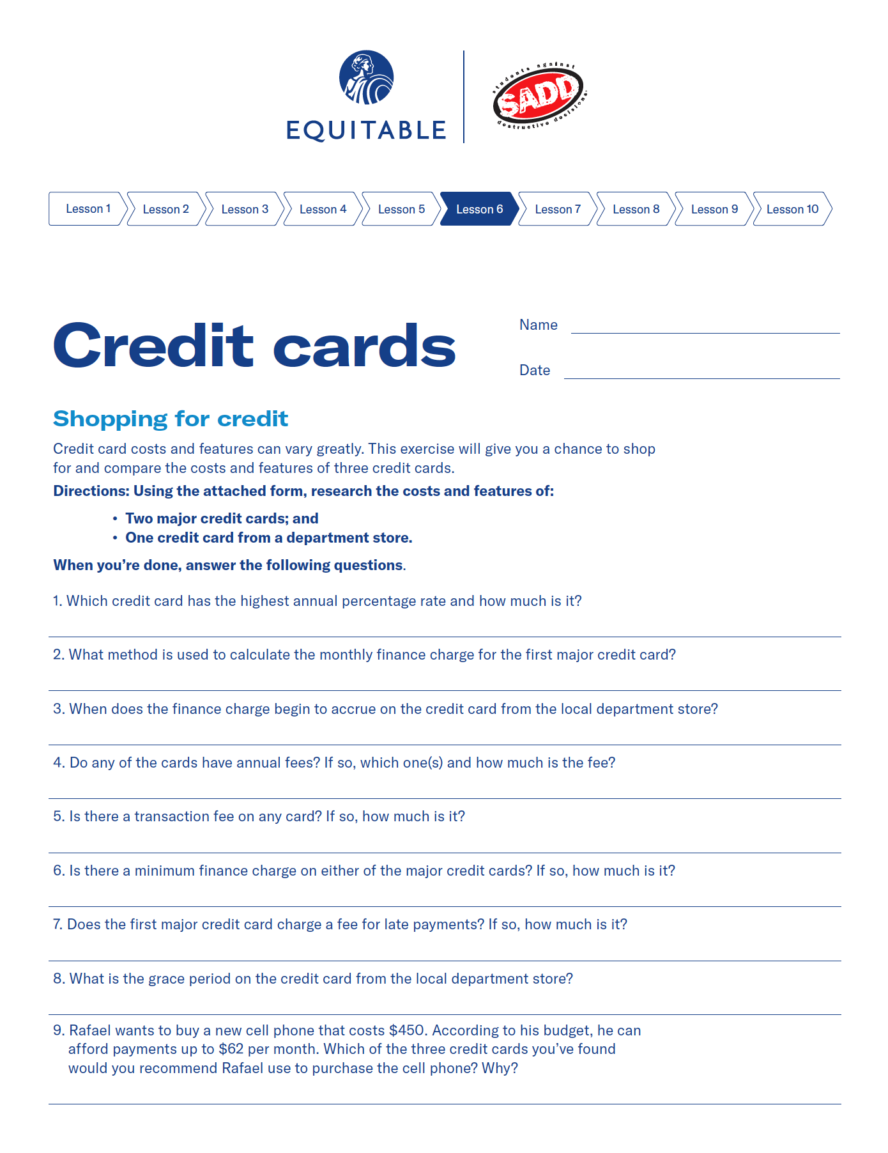
Making decisions — lesson 6 exercise
Lesson 6
Credit cards
Worksheet 6-2: What does your statement tell you?
A credit card statement provides information such as how and when you’ve used your credit card, how much you owe, how much interest you’re paying to use the card, how much your minimum payment is and how much credit you have left.
Knowing how to read your credit card statement can also help you catch unauthorized charges and/or billing errors. It can pay to know how to read the statement.
Use the credit card statement below to answer these questions.
Notes:
**Depending on how much time there is to complete the lesson, you may complete this activity as a class, have students complete individually, or skip.
Notes to presenter:
■ Students can take a close look at a credit card statement and see what kind of
information it contains.
■ Using the credit card statement provided, have students answer the questions attached
to the statement.

Slide 8
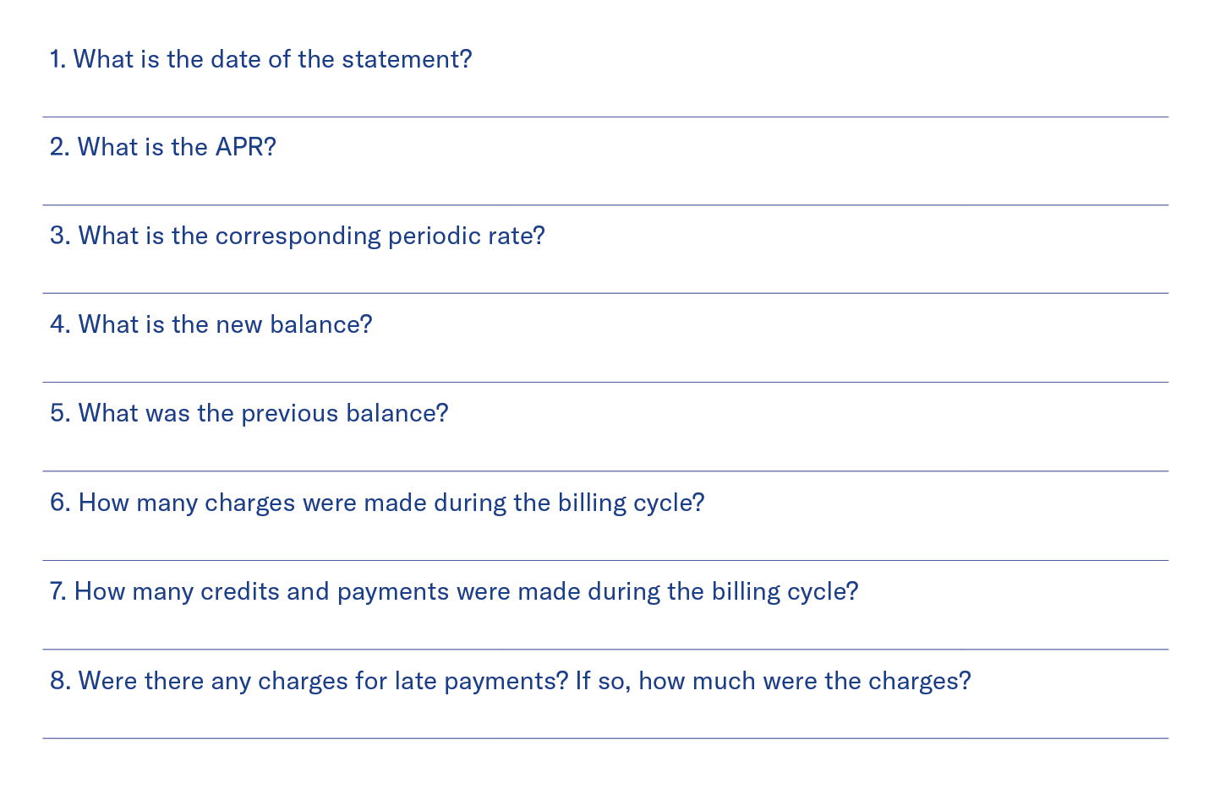
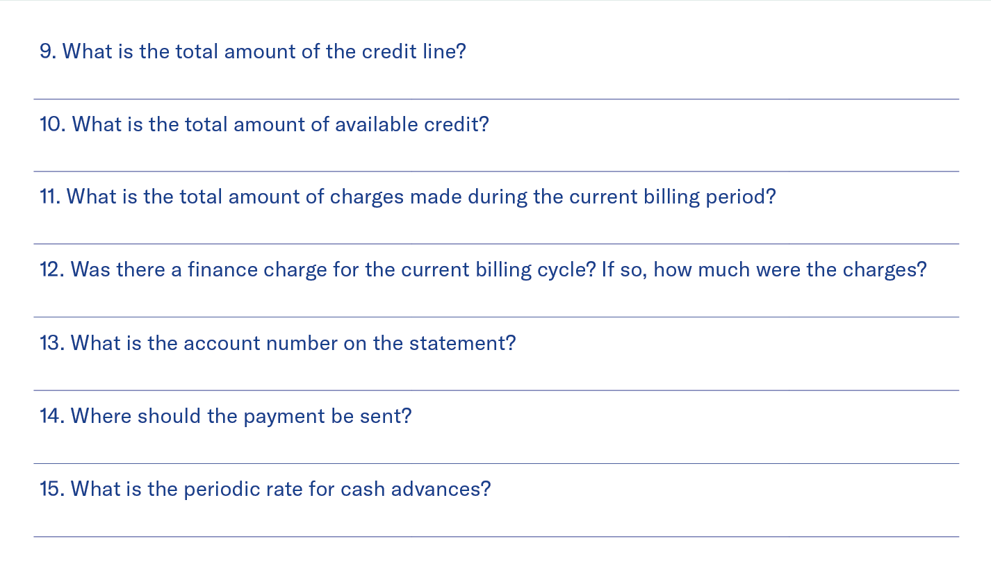
Making decisions — lesson 6 exercise
Lesson 6
Credit cards
What does your statement tell you?
February 13, 2008
$1,200
19.8%
$1,074.76
1.65%
$125.24
$125.24
No, none
$168.80
4125-239-412
Five
Box 1234, Anytown, USA
One
0.54%
No, none
Notes:
Notes to presenter:
■ Students can take a close look at a credit card statement and see what kind of
information it contains.
■ Using the credit card statement provided, have students answer the questions attached
to the statement.
*questions and answers appear per click

Slide 9
What to do if you’re denied credit
Lesson 6
Credit cards
If you think the reasons for the denial are valid:
If you are not sure whether the reason for the denial is valid:
If you believe the reason for the denial is invalid and the creditor has discriminated against you:
Ask the creditor if you can provide additional information or arrange alternate credit terms.
Apply to another creditor whose standards may be different.
Do the things you need to do to improve your creditworthiness (pay bills on time, increase income, reduce spending, obtain a secured card, etc.) and then reapply.
Ask the creditor to explain why you were denied.
Review your credit history.
If you find your credit history contains errors, take steps to correct the errors.
Notify the federal enforcement agency whose name you were given by the creditor. The federal enforcement agency will investigate and report back to you.
If you can afford to, hire an attorney to file suit against the creditor. If the court determines the creditor did discriminate, the creditor will be required to pay you actual damages plus punitive damages.
Notes:
Review steps to take in a situation where credit is denied

Slide 10
Lesson 6
Other credit card protections
Credit cards
Prompt credit for payment
Unauthorized charges
A card issuer must credit your account on the day the issuer receives your payment, unless the payment is not made according to the creditor’s requirements.
If you report your card lost before it is used, you cannot be held responsible for any unauthorized charges.
If your card is used before you report it lost, you are liable for $0 if reported within 2 business days. After that, you’re liable for no more than $50.
Refunds of credit balances
Disputes about merchandise or services
When you return merchandise or pay more than you owe, you have the option of keeping the credit balance on your account or receiving a refund.
In some circumstances, you have the right to withhold payment for unsatisfactory merchandise or services.
Notes:
Review the following concepts:
other credit card protections
1. Prompt credit reporting
■ Your account must be credited on the day your
payment is received.
2. Refunds of credit balances
■ If requested, card issuer must send refund within
seven business days of receiving your request.
3. Unauthorized charges
■ If you are the victim of identity theft or card
fraud, you will typically not be held responsible for
the charges under the card's zero-liability program.
4. Disputes about merchandise or services
■ In some circumstances, you have the right to
dispute payment for merchandise or services.
how you can protect yourself
1. Keep records of:
■ Card number
■ Phone number to call if card is lost or stolen
■ Until bill arrives, receipts for purchases and returns
■ Receipts for merchandise ordered that has not yet
arrived but appears on your bill
■ Record of telephone orders and confirmation
numbers
2. Protect yourself against fraud
■ When using your card, keep your card in sight.
■ Never give card number over the phone if you did
not initiate the call.
■ Report lost or stolen cards immediately.
■ Carefully read the bills before paying. Compare
amount on receipts to amounts on bill. Don’t
always assume the bill is correct.
■ Keep receipts; shred when not needed.
■ Destroy unused credit card solicitations.
■ Shop only on secure websites.
■ Don't write down your pin and carry it with
your card.

Slide 11
Lesson 6
Credit card dos and don’ts
Credit cards
Shop around
Read and understand the contract
Know your cost
Look at various sources.
Read the contract carefully.
Don’t rush into signing anything.
Once a contract is signed, get a copy of it.
Know the penalties for missed payments.
Figure out total price when paying with credit.
Make the largest payments possible.
Know the penalties for missed payments.
Buy on installment credit only after you have evaluated all other possibilities.
Don’t be misled into thinking small payments will be easy.
Notes:
Discuss the following concepts with the class:
summary of credit card dos and don’ts
1. Shop around.
2. Look at various sources.
3. Read the contract carefully.
4. Don’t rush into signing anything.
5. Once signed, get copy of contract.
6. Know the penalties for missed payments.
7. Figure out total price when paying with credit.
8. Pay bills in full or at least make the largest payments
you comfortably can.
9. Don’t be misled into thinking small payments
will be easy
advantages of using credit cards
1. Ability to obtain needed items
2. Use of card builds credit history
3. Quick source of funds in an emergency
4. No extra charge if bill is paid in full each month
5. Consumer protection
disadvantages of using credit cards
1. Credit cards are loans that charge interest if not paid
in full
2. Fees might be charged for late payments or going
over spending
3. Can encourage impulse buying and unnecessary
purchases
4. Need to establish creditworthiness before getting card

Slide 12
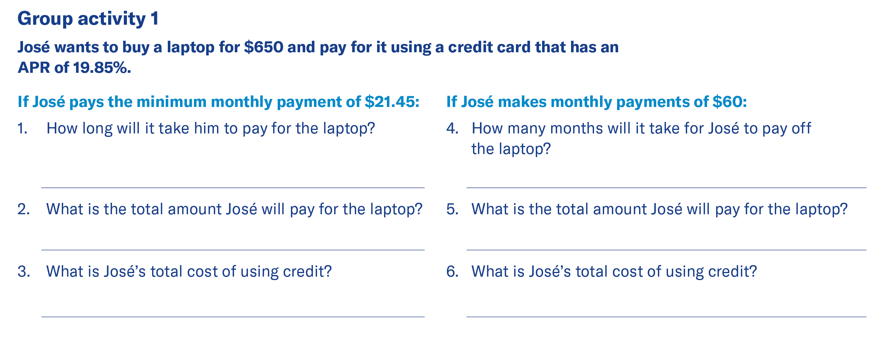
Lesson 6
Making decisions – lesson 6 exercise
Credit cards
Worksheet 6-3: How much does it really cost?
Use the cost of credit calculator at practicalmoneyskills.com to answer the following questions.
43 months
13 months
$909.54
$722.20
$259.54
$72.20
Notes:
**Depending on how much time there is to complete the lesson, you may complete this activity as a class, have students complete individually, or skip.
*Activity covers slides 12-16
Notes to presenter:
- Have students calculate the total cost of items bought on credit and what the eventual
cost of those items will be if only the minimum payment is made and interest charges
accrue.
- Have students answer the questions. Discuss their answers. Was anyone surprised at
their answers? Would they have made different choices about buying the items?
- This can be a good time to talk about values, needs versus wants, budgeting, and
the pros and cons of using credit.
*Answers appear with click.

Slide 13
Lesson 6
Making decisions – lesson 6 exercise (cont.)
Credit cards
Worksheet 6-3: How much does it really cost?
31 months¹
14 months¹
$1,997.70
$1,734.50
$497
$234.50
1 Based on a total advance of $1,535 ($1,500 + $35 transaction fee).
Notes:
**Depending on how much time there is to complete the lesson, you may complete this activity as a class, have students complete individually, or skip.
Notes to presenter:
- Have students calculate the total cost of items bought on credit and what the eventual
cost of those items will be if only the minimum payment is made and interest charges
accrue.
- Have students answer the questions. Discuss their answers. Was anyone surprised at
their answers? Would they have made different choices about buying the items?
- This can be a good time to talk about values, needs versus wants, budgeting, and
the pros and cons of using credit.
*Answers appear with click.

Slide 14
Lesson 6
Making decisions – lesson 6 exercise (cont.)
Credit cards
Worksheet 6-3: How much does it really cost?
19 months
40 months
$473.39
$559.36
$73.39
$159.36
Notes:
**Depending on how much time there is to complete the lesson, you may complete this activity as a class, have students complete individually, or skip.
Notes to presenter:
- Have students calculate the total cost of items bought on credit and what the eventual
cost of those items will be if only the minimum payment is made and interest charges
accrue.
- Have students answer the questions. Discuss their answers. Was anyone surprised at
their answers? Would they have made different choices about buying the items?
- This can be a good time to talk about values, needs versus wants, budgeting, and
the pros and cons of using credit.
*Answers appear with click.

Slide 15
Lesson 6
Making decisions – lesson 6 exercise (cont.)
Credit cards
Worksheet 6-3: How much does it really cost?
$300.70
$257.71
31 months
11 months
$65.70
$22.71
Notes:
**Depending on how much time there is to complete the lesson, you may complete this activity as a class, have students complete individually, or skip.
Notes to presenter:
- Have students calculate the total cost of items bought on credit and what the eventual
cost of those items will be if only the minimum payment is made and interest charges
accrue.
- Have students answer the questions. Discuss their answers. Was anyone surprised at
their answers? Would they have made different choices about buying the items?
- This can be a good time to talk about values, needs versus wants, budgeting, and
the pros and cons of using credit.
*Answers appear with click.

Slide 16
Lesson 6
Making decisions – lesson 6 exercise
Credit cards
Worksheet 6-4: How deep can they go?
$120
$1,200 x 10% = $120
$0
$800 x 10% = $80
$80 – $80 = $0
Notes:
**Depending on how much time there is to complete the lesson, you may complete this activity as a class, have students complete individually, or skip.
Notes to presenter:
- Students determine safe debt loads for several consumers.
- Have students answer the questions and document how they arrived at each answer.
When they’re done, review the answers and the formulas used.

Slide 17
Lesson 6
Making decisions – lesson 6 exercise
Credit cards
Worksheet 6-4: How deep can they go?
$45
$450 x 10% = $45
(A) $640 x 12 = $7,680
(B) $640 x 10% = $64
(C) 26%
$7,680 x 20% = $1,536
$125 + $40 = $165
$165 / $640 = 26%
No – 26% is over safe debt load.
Notes:
Notes to presenter:
- Students determine safe debt loads for several consumers.
- Have students answer the questions and document how they arrived at each answer.
When they’re done, review the answers and the formulas used.

Slide 18
Lesson 6
Credit cards
Lesson 6 quiz

Slide 19
Lesson 6
Lesson 6 quiz
Credit cards
T
F
F
T
T
Notes:
If there is time, allow students to complete the quiz, then review the answers with them. Answers are featured in slide slow mode with each click.

Slide 20
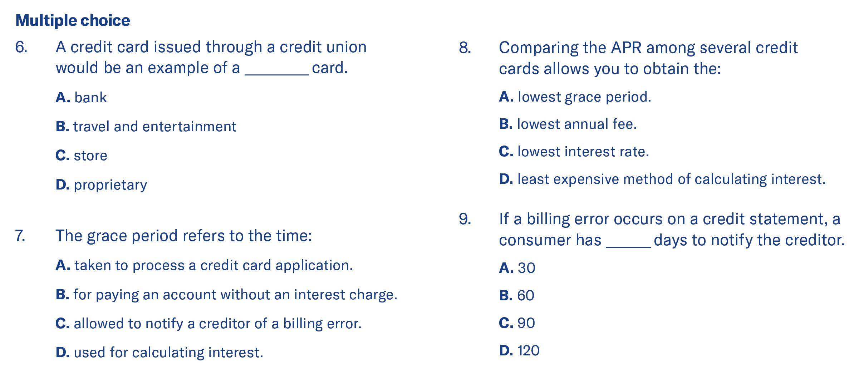
Lesson 6
Lesson 6 quiz
Credit cards
A
C
B
B
Notes:
If there is time, allow students to complete the quiz, then review the answers with them. Answers are featured in slide slow mode with each click.

Slide 21
Lesson 6
Lesson 6 quiz
Credit cards
If Jack pays off his balances each month, his use of credit cards may be a convenient money management technique that provides complete records of all of his spending. However, if this habit results in overspending and paying more due to interest, Jack needs to assess his financial activities.
Notes:
If there is time, allow students to complete the quiz, then review the answers with them. Answers are featured in slide slow mode with each click.

Slide 22
Important information
Equitable is the brand name of the retirement and protection subsidiaries of Equitable Holdings, Inc., including Equitable Financial Life Insurance Company (NY, NY); Equitable Financial Life Insurance Company of America, an AZ stock company; and Equitable Distributors, LLC. Equitable Advisors is the brand name of Equitable Advisors, LLC (member FINRA, SIPC) (Equitable Financial Advisors in MI & TN). The obligations of Equitable Financial and Equitable America are backed solely by their claims-paying abilities.
© 2023 Equitable Holdings, Inc. All rights reserved. GE-5492439.1 (3/23) (Exp. 3/25) | G2090239 | Cat. #161877 (3/23)

Slide 24
Thank you.
Notes:
Read Slide

