Slide 1
Using credit
Lesson 5
Speaker/team/other
Month 00, 2022

Slide 2
Advantages and disadvantages of credit
Lesson 5
Using credit
Advantages:
Able to buy items needed now
Don’t have to carry cash
Creates a record of purchases
More convenient than writing checks
Consolidates bills into one payment
Disadvantages:
Interest (higher cost of items)
May require additional fees
Financial difficulties may arise if one loses track of how much has been spent each month
Increased impulse buying may occur
Using credit — Month 00, 2022
Notes:
Discuss the following:
What is consumer credit?
Definition
Brief history
Why get credit?
Establish credit history
Advantages of having credit
Buying needed or wanted services and goods using anticipated future income
Having a record of purchases
Consolidating bills
3. Disadvantages of having credit
Interest payments
Overspending becomes too easy
Financial trouble may arise if card is not managed properly
Option to have students complete worksheet activity 5-1

Slide 3
Lesson 5
Lesson 3
The three Cs
Using credit
The art of
budgeting
Character
Will you repay the debt?
Capital
What if you don’t repay the debt?
Capacity
Can you repay the debt?
From your credit history, does it look like you possess the honesty and reliability to pay credit debts?
Do you have any valuable assets, such as real estate, savings or investments that could be used to repay credit debts if income is unavailable?
Have you been working regularly in an occupation that’s likely to provide enough income to support your credit use?
Have you used credit before?
Do you pay your bills on time?
Do you have a good credit report?
Can you provide character references?
How long have you lived at your present address? How long have you been at your present job?
Do you own any property than can secure the loan? Do you have a savings account?
Do you have investments to use as collateral?
Do you have a steady job? What is your salary?
How many other loan payments do you have?
What are your current living expenses? What are your current debts? How many dependents do you have?
Using credit — Month 00, 2022
Notes:
Discuss the following:
why banks issue credit?
To make money
To offer service to customers
Creditworthiness (The 3 C’s)
Character
Capital
Capacity
Option to have students complete worksheet activity 5-b

Slide 4
Lesson 5
Your responsibilities
Using credit
Borrow only what you can repay.
Read and understand the credit contract.
Pay debts promptly.
Notify creditor if you cannot meet payments.
Report lost or stolen credit cards promptly.
Never give your card number over the phone unless you initiated the call or are certain of the caller’s identity.
Using credit — Month 00, 2022
4
Notes:
Discuss the following concepts:
Not to run up more debt than you can comfortably repay
Not to exceed the credit limit established by your creditor
Not to re-sell merchandise before completely paying the creditor, if the creditor has retained the title or has a lien against it
To notify the creditor immediately if your credit card is lost or stolen

Slide 5
Your rights
Lesson 5
Using credit
Truth in Lending Act (1968)
Fair Credit Reporting Act (1970)
Equal Opportunity Act (1974)
Fair Credit Billing Act (1974)
Fair Debt Collection Practices Act (1977)
Ensures consumers are fully informed about cost and conditions of borrowing.
Protects the privacy and accuracy of information in a credit check.
Prohibits discrimination in giving credit on the basis of sex, race, color, religion, national origin, marital status, age or receipt of public assistance.
Sets up a procedure for the quick correction of mistakes that appear on consumer credit accounts.
Prevents abuse by professional debt collectors and applies to anyone employed to collect debts owed to others; does not apply to banks or other businesses collecting their own accounts.
Using credit — Month 00, 2022
Notes:
Discuss the following concepts:
Truth in Lending Act
Fair Credit Reporting Act
Equal Opportunity Act
Fair Credit Billing Act
Fair Debt Collection Practices Act
State Statues
- Restricting the amount of interest that can be charged (usury laws)
- To obtain more extensive information

Slide 6
Lesson 5
Building a credit history
Using credit
Establish a steady work record.
Pay all bills promptly.
Open a checking account and don’t bounce checks.
Open a savings account and make regular deposits.
Apply for a local store credit card and make regular monthly payments. Apply for a small loan using your savings account as collateral.
Get a co-signer on a loan and pay back the loan as agreed.
Using credit — Month 00, 2022
6
Notes:
Discuss the following concepts:
Building a credit history:
Credit bureaus—what they are and how they work
How to establish a good credit history
- Pay bills on time
- Get a low limit credit card or other loan and pay bills promptly

Slide 7
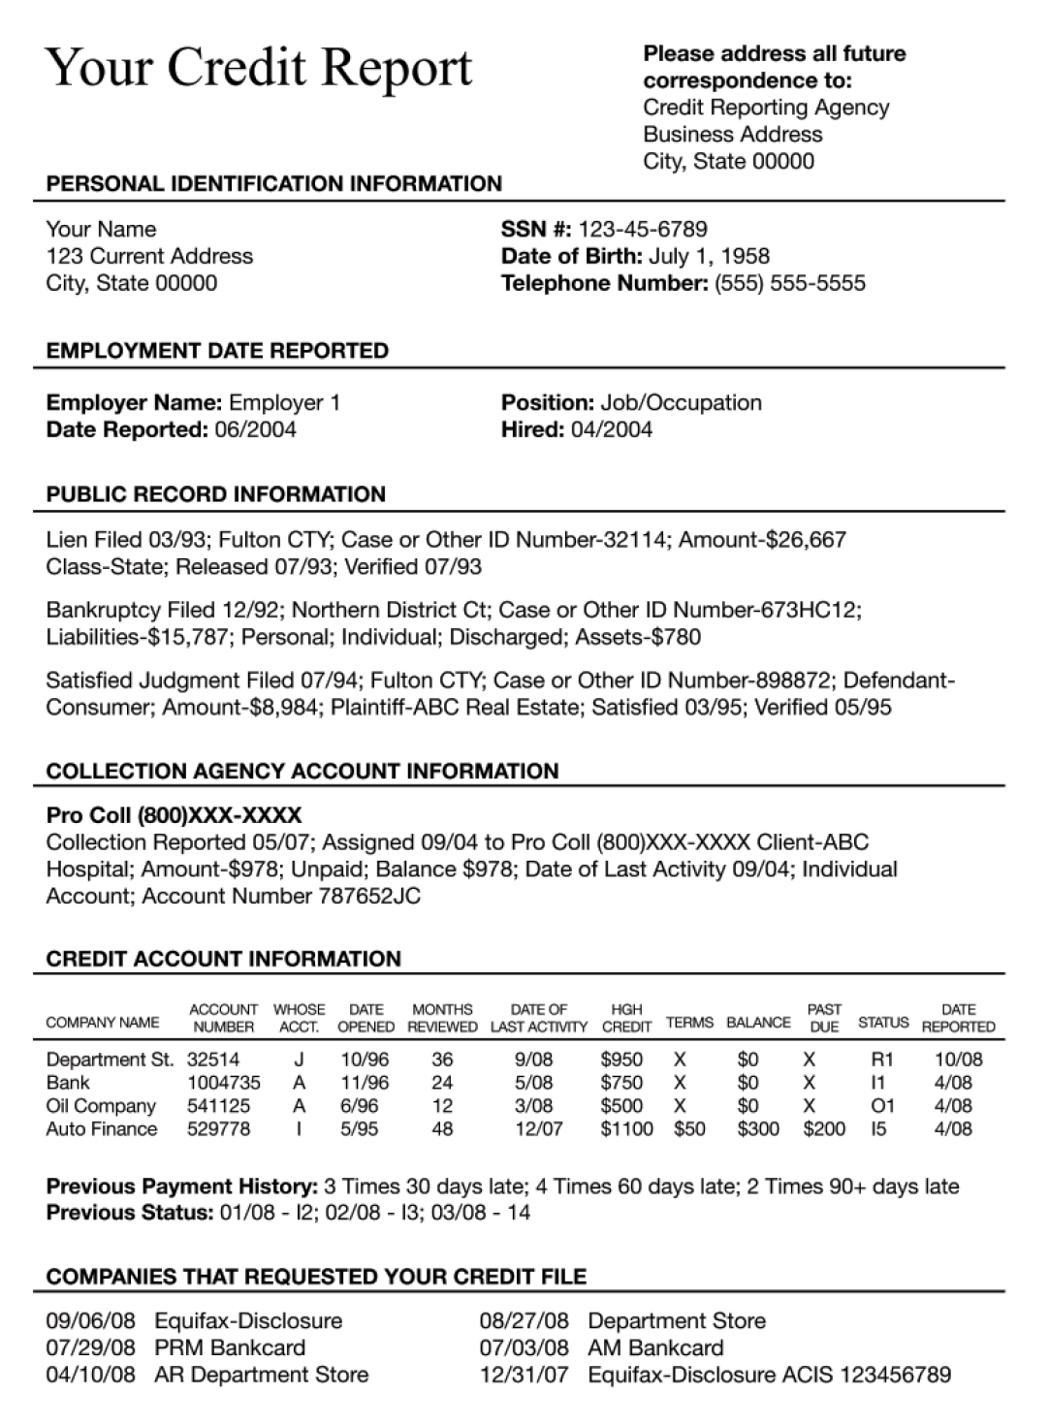
Reading a credit report
Lesson 5
Using credit
Using credit — Month 00, 2022
Notes:
a credit report
1. What a credit report covers and what it looks like
■ Identification and employment data
■ Payment history
■ Inquiries
■ Public record information
2. Credit scoring, manner of payment codes
■ How you can get a black mark
■ What creditors look for—the three Cs
3. What to do if you have a bad credit report
4. How time affects your credit report
5. How to handle mistakes
types of credit
1. Noninstallment credit
■ Regular
■ 30-day charge accounts
■ Travel and entertainment cards
■ How to use and best time to use
(paid off every month)
2. Regular installment credit
■ Car loan
■ How to use and best time to use
3. Revolving credit
■ Department store cards
■ Bank cards
■ How to use and best time to use
Option to have students complete remainder of worksheet activity 5-2

Slide 8
How much can you afford?
Lesson 5
Using credit
The 20–10 Rule
Monthly payments shouldn’t exceed 10% of your monthly net income
Never borrow more than 20% of your yearly net income
If you earn $400 a month after taxes, then your net income in 1 year is:
12 months x $400/mo = $4,800
If your take–home pay is $400 a month:
$400 x 10% = $40
Calculate 20% of your annual net income to find your safe debt load.
$4,800 x 20% = $960
So, you should never have more than $960 of debt outstanding.
Your total monthly debt payments shouldn’t total more than $40 per month.
Note: Housing debt (i.e., mortgage payments) should not be counted as part of the 20%, but other debt should be included, such as car loans, student loans and credit cards.
Note: Housing payments (i.e., mortgage payments) should not be counted as part of the 10%, but other debt should be included, such as car loans, student loans and credit cards.
Using credit — Month 00, 2022
Notes:
Review the following concept:
How much can you afford?
The 20-10 rule
- what it means
- examples
2. Exercises

Slide 9
Lesson 5
Using credit
Lesson 5 quiz

Slide 10
Lesson 5
Lesson 5 quiz
Using credit
True/False
1. |  | A disadvantage of using credit is impulse buying.
2. |  | Capital refers to a person’s assets.
3. |  | A steady employment record helps a person’s credit history.
4. |  | Installment credit usually allows a person to make additional purchases on an account.
5. |  | Using the 20–10 rule, a person making $40,000 a year after taxes should have no
 |  | more than $8,000 of outstanding debt.
T
T
T
F
T
Multiple choice
6. |  | A common advantage of using credit is:
 |  | A. Less impulse buying B. Lower cost for items purchased C. Ability to obtain items needed now D. Lower chance of overspending
7. |  | A person’s regular income is
 |  | referred to as:
 |  | A. Character B. Capital C. Collateral D. Capacity
C
D
Using credit — Month 00, 2022
Notes:
If there is time, allow students to complete the quiz, then review the answers with them. Answers are featured in slide slow mode with each click.

Slide 11
Lesson 5
Lesson 5 quiz
Using credit
Multiple choice
8. |  | To build credit history, a person could:
 |  | A. Establish a steady employment record B. File their federal income taxes on time C. Use an ATM several times a month D. Request to view their credit file
9. |  | Utility companies and medical service organizations
 |  | commonly offer credit.
 |  | A. Revolving B. Single-payment C. Installment D. Retail
A
B
10. |  |  | Using the 20–10 rule, a person earning $1,500 a month
 |  |  | should not have monthly credit payments that exceed:
 |  |  | A. $300 B. $150 C. $20 D. $30
B
Using credit — Month 00, 2022
Notes:
If there is time, allow students to complete the quiz, then review the answers with them. Answers are featured in slide slow mode with each click.

Slide 12
Lesson 5
Lesson 3
Lesson 5 quiz
Using credit
The art of
budgeting
Ana Gonzalez is considering a loan to finance her college education. She currently owes money on several charge accounts and credit cards. What actions would you recommend?
While this is a valid reason for using credit, Ana might consider paying off some of her other debts before taking on this new loan. She might delay starting school full time until she has paid off her other accounts.
Using credit — Month 00, 2022
Notes:
If there is time, allow students to complete the quiz, then review the answers with them. Answers are featured in slide slow mode with each click.

Slide 13
Important information
Equitable is the brand name of the retirement and protection subsidiaries of Equitable Holdings, Inc., including Equitable Financial Life Insurance Company (Equitable Financial) (NY, NY); Equitable Financial Life Insurance Company of America (Equitable America), an AZ stock company with main administrative headquarters in Jersey City, NJ; and Equitable Distributors, LLC. Equitable Advisors is the brand name of Equitable Advisors, LLC (member FINRA, SIPC) (Equitable Financial Advisors in MI & TN).
© 2022 Equitable Holdings, Inc. All rights reserved. GE-4763004.1 (7/22) (Exp. 7/24) | G1745227 I Cat. # 164717 (7/22)
Using credit — Month 00, 2022

Slide 15
Thank you.

