Slide 1
Lesson 9
Financial
wellness
Speaker/team/other
Month 00, 2023
Notes:
Note to speaker: introduce yourself and the lesson
Review the broad concept of financial wellness with students. What does it mean to you. The content to follow involves topics that can cause financial stress (paying for college, debt, etc.) Since those are topics that could cause stress, make sure to keep the discussion positive but informative.

Slide 2
Making big decisions
Lesson 9
Financial
wellness
Paying for college, buying a home and making other large purchases can lead to financial stress.
It’s important to utilize what you’ve learned so far about budgeting, credit, etc. to ensure you are being realistic with your finances.
Financial well-being:
A state wherein a person can fully meet current and ongoing financial obligations, can feel secure in their financial future and is able to make choices that allow enjoyment of life.
Notes:
Describe financial well-being and explain how students can utilize what they’ve learned thus far in previous lessons to achieve financial well-being.

Slide 3
Paying for college
Lesson 9
Financial
wellness
The cost to attend college has soared faster than almost any segment of the economy over the last 30 years.
That’s the primary reason Americans are $1.7 trillion in debt on student loans.¹
The good news is there are hundreds of online sites offering tips on not just what it will cost, but what you can do to pay for it. Don’t let this lead to your financial stress.
Tuition and fees vary from college to college. The average cost of yearly tuition for the 2022–2023 school year was $39,723 at private colleges, $10,423 for state residents at public colleges and $22,953 for out-of-state students at state schools.²
1 forbes.com/advisor/student-loans/average-student-loan-statistics/
2 usnews.com/education/best-colleges/paying-for-college/articles/what-you-need-to-know-about-college-tuition-costs
Notes:
Review topic of college and how to pay for it.
Student Loans
Scholarships
Costs of college (not just tuition)
books/supplies for classes
Meals (outside of meal plan)
Transportation if commuting and not on campus, etc.

Slide 4
Debt
Lesson 9
Financial
wellness
Debt is something owed or due. Usually, debt is in the form of money, but it can also be items, services, favors, etc. If you make an agreement to give or do something, you now owe a debt.
Student loan debt
Credit card debt
Medical debt
In 2023, Forbes reported the total U.S. student debt was $1.75 trillion and that 43 million people owed debt. The average student debt is $28,950.³
Student loans are the second-largest type of consumer debt, falling behind mortgage debt.⁴
The average credit card debt for American households is $7,486.⁵
Thirty-five percent of all households carry some sort of credit card debt.⁶
Twenty-three million people (nearly 1 in 10 adults) owe significant medical debt, at least $195 million collectively.⁷
The Consumer Financial Protection Bureau (CFPB) estimates that $88 billion in medical debt is reflected on Americans’ credit reports.⁷
3 forbes.com/advisor/student-loans/average-student-loan-statistics/
4 bankrate.com/loans/student-loans/student-loan-debt-statistics/#key-statistics
5 thehill.com/finance/3821799-a-growing-number-of-americans-face-potentially-crippling-credit-card-debt/
6 bankrate.com/finance/credit-cards/states-with-most-credit-card-debt/
7 healthsystemtracker.org/brief/the-burden-of-medical-debt-in-the-united-states/
Notes:
Explain the concept of debt and different types of common debts
Student Loan Debt
Credit Card Debt
Medical debt

Slide 5
How to handle financial stress
Lesson 9
Financial
wellness
Make a plan
Keep yourself honest
Set a goal.
Stick to a budget.
Outline your payment plan.
Track your progress and hold yourself accountable.
Be realistic
Make one decision at a time
Determine what you can realistically achieve and then dedicate yourself to following through each month.
Don’t try to take on too much at once. Focus on each decision and give it the attention it deserves.
Small steps are key
Ask for support
Even baby steps move you toward your goal. A little bit now can mean a lot later.
Financial stress can cause anxiety, which can lead to other poor decisions.
Don’t be afraid to ask for help – there are plenty of resources available to you.
Notes:
Discuss ways to handle financial stress which is often caused by debts.

Slide 6
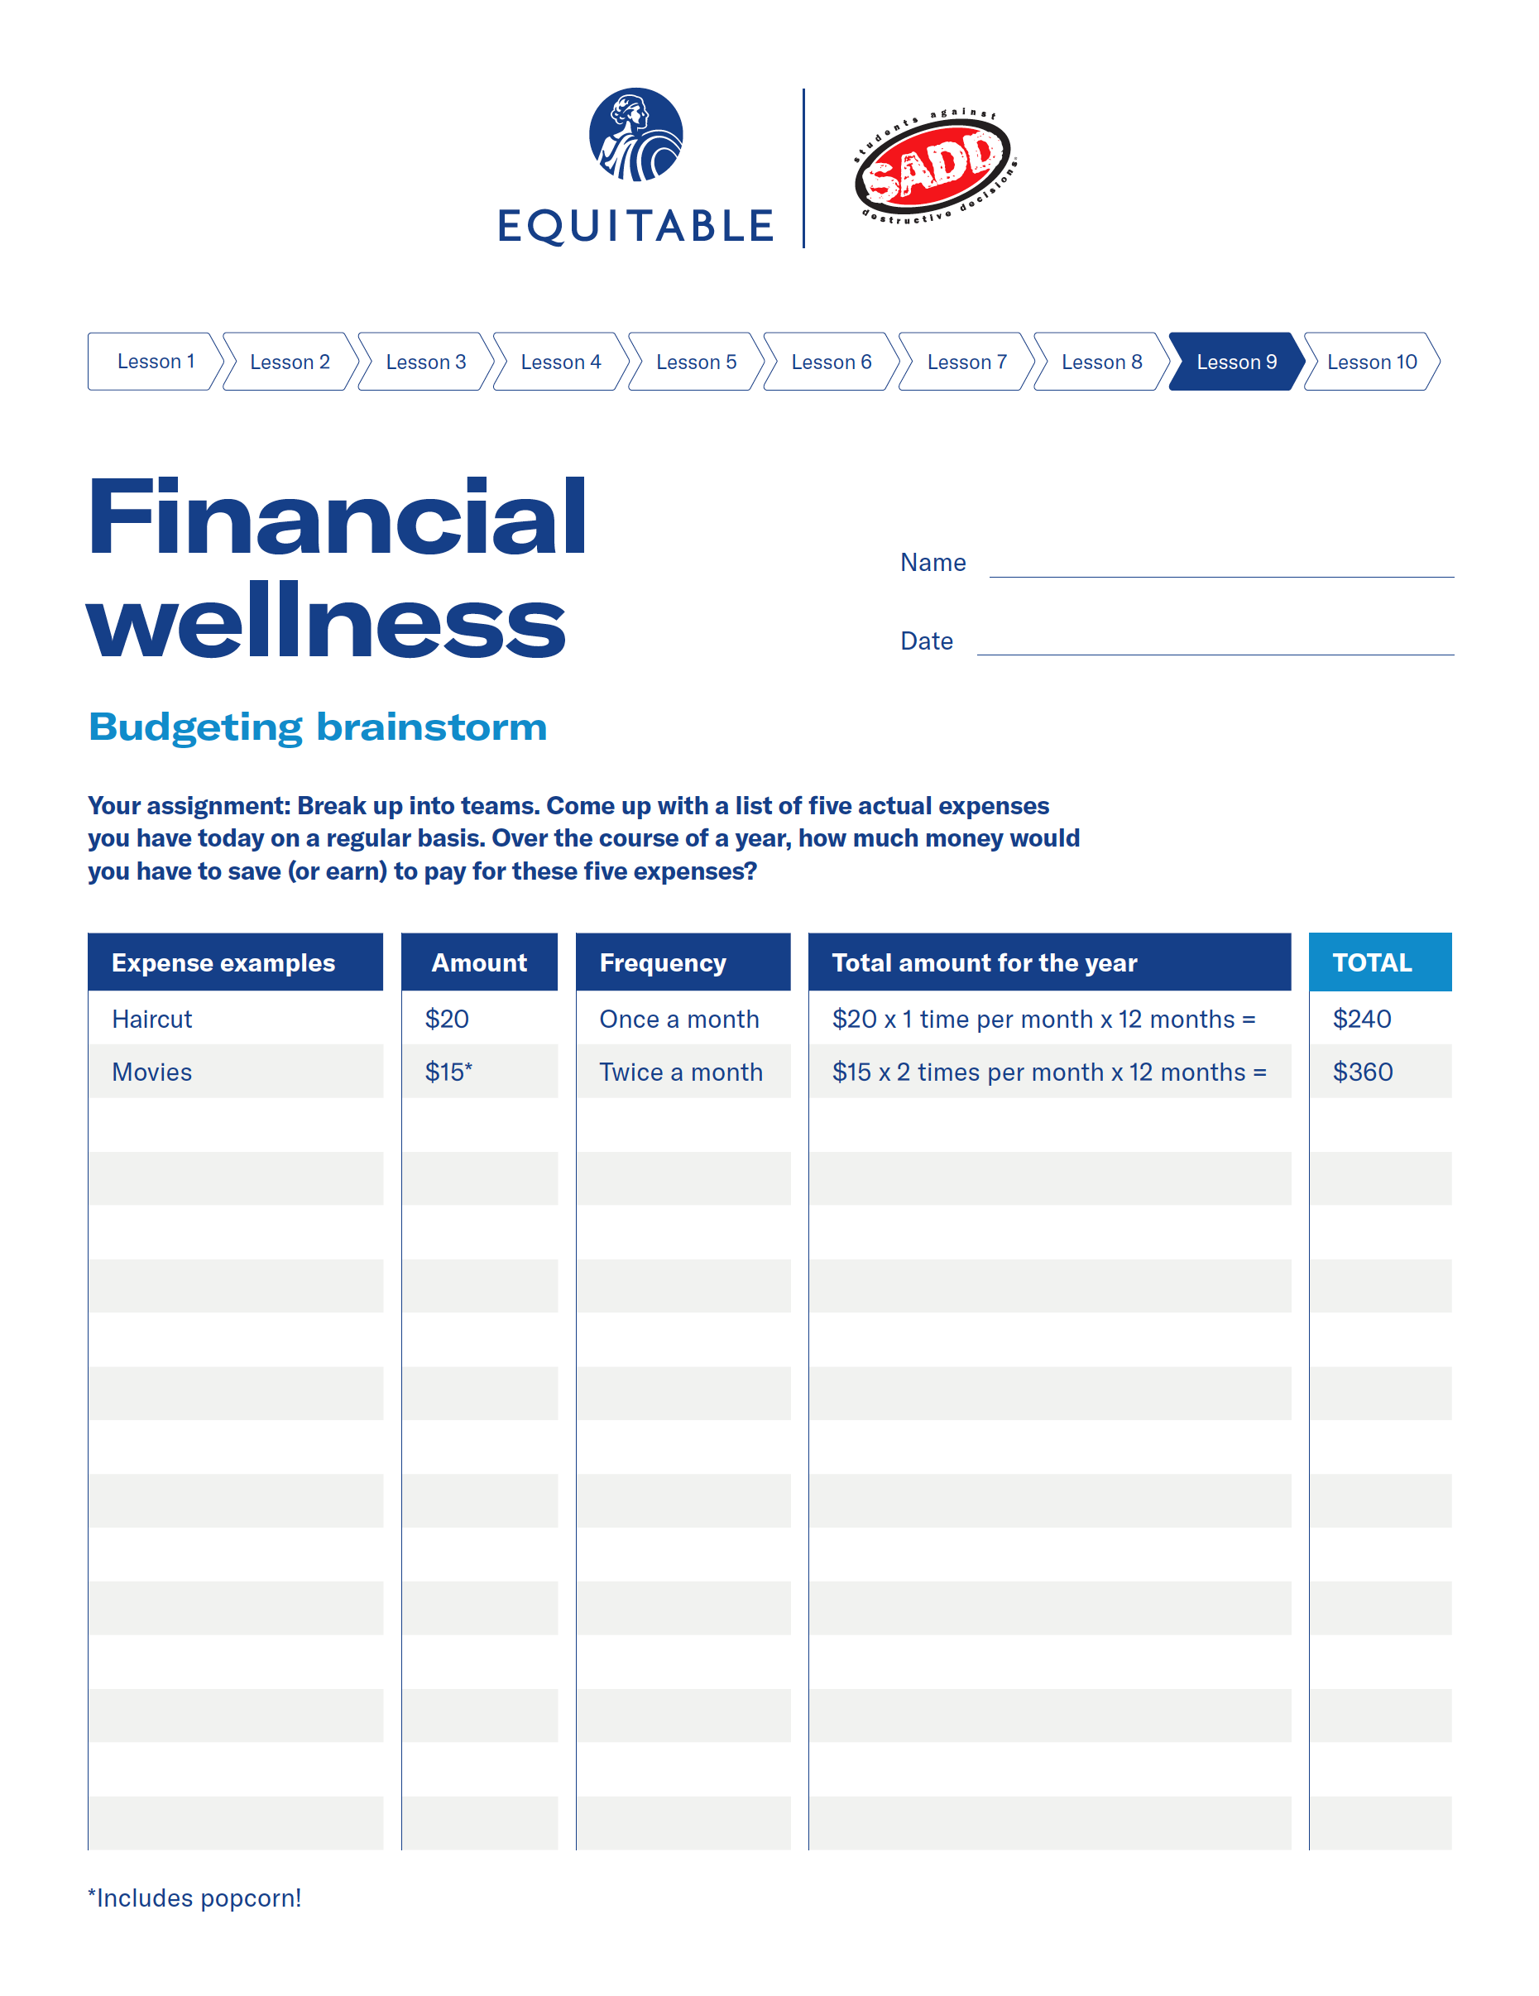
Financial wellness — lesson 9 exercise
Lesson 9
Financial
wellness
Option 1
activity
Depending on how much time there is to complete the lesson, you may select one of the following worksheet exercises for the students to complete.
Worksheet 9-1: budgeting brainstorm
Your assignment: Break up into teams. Come up with a list of five actual expenses you have today on a regular basis. Over the course of a year, how much money would you have to save (or earn) to pay for these five expenses?
Notes:
Note to presenter:
Have the students separate into to teams for this activity. Discuss results as a class.

Slide 7
Financial wellness — lesson 9 exercise
Lesson 9
Financial
wellness
Option 2
activity
Depending on how much time there is to complete the lesson, you may select one of the following worksheet exercises for the students to complete.
Worksheet 9-2: finding your financial balance
When it comes paying for your regular living expenses and still being able to save some money toward funding your financial goals, it’s a balancing act between goals. It takes focus and discipline, but it can be done!
Your assignment:
Break up into teams. Each team has a part-time job on weekends. Assume your monthly pay from your part-time job is $500. Using the following lists, pick two financial goals from the list on the top to save for (feel free to come up with other examples on your own). You must come up with an estimated cost for each goal and you have 6 months to save for both goals. Then pick four expenses from the list on the bottom that you have to pay for on an ongoing basis (feel free to come up with other examples on your own). Estimated expense amounts have been provided.
Notes:
Note to presenter:
Have students break up into teams and choose a part time job. They should complete the worksheet then discuss as a class.

Slide 8
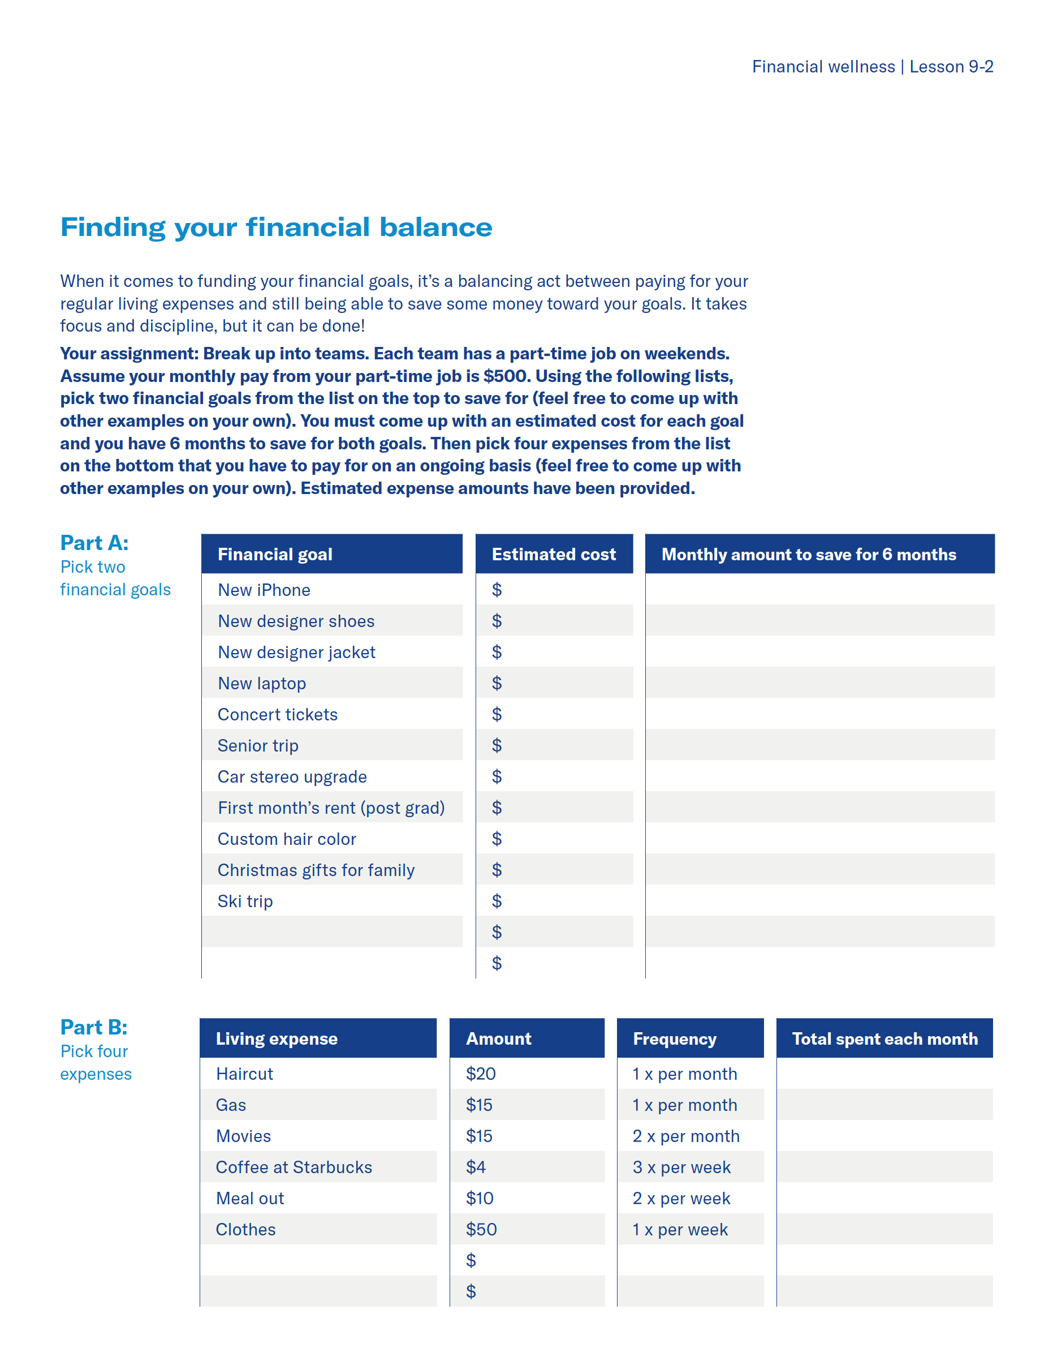
Financial wellness — lesson 9 exercise
Lesson 9
Financial
wellness
Option 3
activity
Depending on how much time there is to complete the lesson, you may select one of the following worksheet exercises for the students to complete.
Worksheet 9-3: Putting it all together/how did you do?
Use the table in the worksheet to figure out your monthly cash flow.
Add up all your monthly expenses and subtract them from your monthly income.
Then, answer the following questions.
Notes:
Review students answers from this activity as a class.

Slide 9
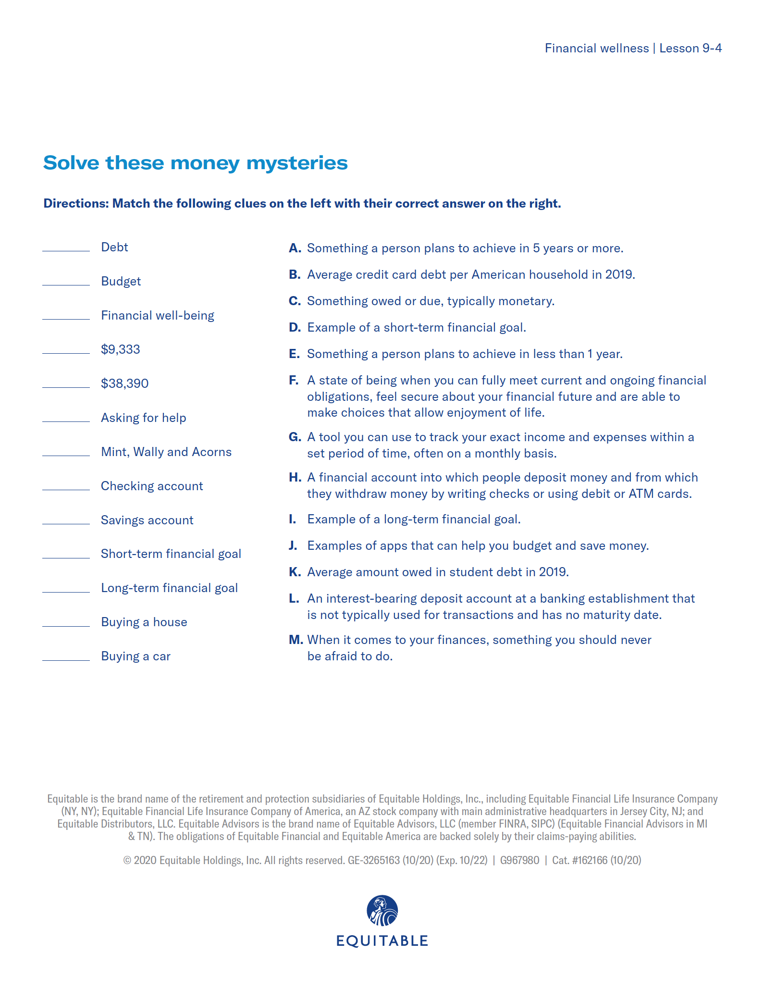
Financial wellness — lesson 9 exercise
Lesson 9
Financial
wellness
Option 4
activity
Depending on how much time there is to complete the lesson, you may select one of the following worksheet exercises for the students to complete.
Worksheet 9-4: solve these money mysteries
Match the following clues on the left with their correct answer on the right.
Notes:
This activity can be done individually or as class – time-permitting.

Slide 10
Important information
Equitable is the brand name of the retirement and protection subsidiaries of Equitable Holdings, Inc., including Equitable Financial Life Insurance Company (NY, NY); Equitable Financial Life Insurance Company of America, an AZ stock company; and Equitable Distributors, LLC. Equitable Advisors is the brand name of Equitable Advisors, LLC (member FINRA, SIPC) (Equitable Financial Advisors in MI & TN). The obligations of Equitable Financial and Equitable America are backed solely by their claims-paying abilities.
© 2023 Equitable Holdings, Inc. All rights reserved. GE-5492679.1 (3/23) (Exp. 3/25) | G2090095 | Cat. #161883 (3/23)

Slide 12
Thank you.
Notes:
Read Slide

