Slide 1
Lesson 7
Cars and
loans
Speaker/team/other
Month 00, 2023
Notes:
Note to speaker: introduce yourself and the lesson
Being prepared is the best way to keep car-buying choices and decisions on the right track. Students need to examine all aspects of the car-buying process including:
understanding the differences between buying and leasing;
Evaluating used cars;
financing;
applying for loans; and finding the best auto insurance.
Goals:
- Investigate the legal and financial responsibilities of buying, maintaining, insuring and operating a car, and translate those responsibilities into monthly budget.

Slide 2
Costs of owning and
operating a motor vehicle
Lesson 7
Cars and
loans
Ownership (fixed) costs:
Depreciation (based on purchase price)
Interest on loan (if buying on credit)
Insurance
Registration fee, license, taxes
Operating (variable) costs:
Gasoline
Oil and other fluids
Tires
Maintenance and repairs
Parking and tolls
Notes:
Review the following concepts:
costs of owning a car
1. Initial purchase price
2. Registration and title costs
3. Sales tax
4. Financing costs
5. Depreciation
6. Insurance
7. Scheduled maintenance
8. Storage (renting garage space)
costs of operating a car
1. Unscheduled repairs and maintenance
2. Gasoline
3. Oil and other fluids
4. Parking and tolls
5. Tickets
Option to have students complete worksheet activity 7-1

Slide 3
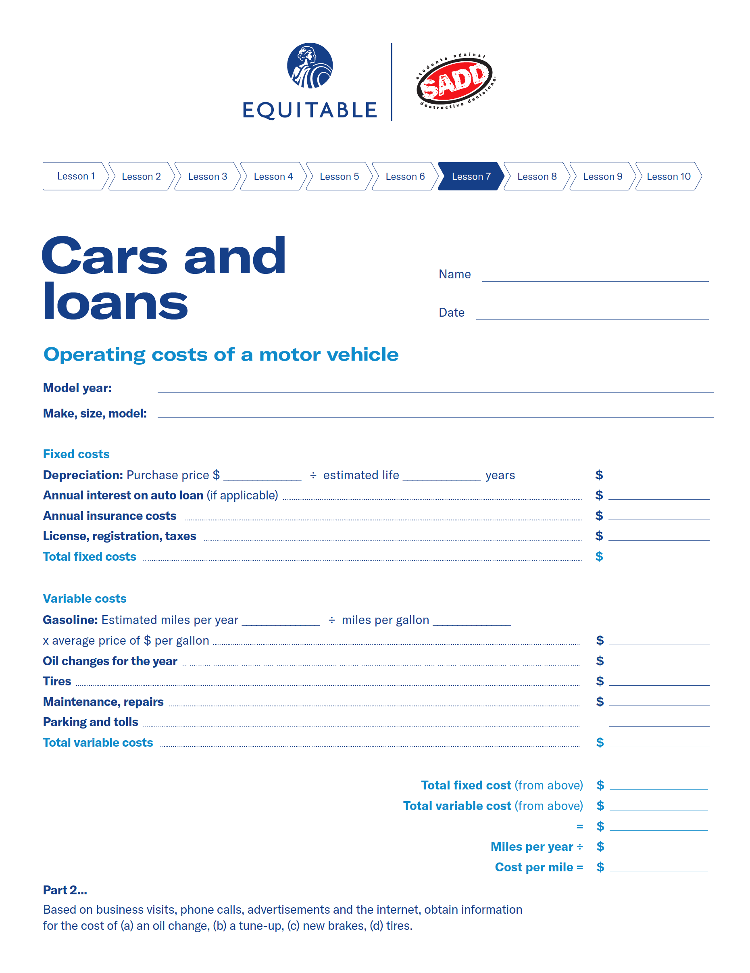
Cars and loans — lesson 7 exercise
Lesson 7
Cars and
loans
Option 1
activity
Depending on how much time there is to complete the lesson, you may select one of the following worksheet exercises for the students to complete.
Worksheet 7-1: Complete the worksheet by estimating costs associated with owning and operating a vehicle.
Plan to discuss responses as a class.
Notes:
Notes to presenter:
Operating Costs of a Motor Vehicle
- Have students estimate various costs associated with owning and operating a
motor vehicle.

Slide 4
Lesson 7
How much can you afford?
The 20-10 Rule
Cars and
loans
Never borrow more than 20% of your yearly net income
Monthly payments shouldn’t exceed 10% of your monthly net income
If you earn $400 a month after taxes, your net income in 1 year is
If your take-home pay is $400 a month
12 x $400 = $4,800
$400 x 10% = $40
Calculate 20% of your annual net income to find your safe debt load
Your total monthly debt payments shouldn’t total more than $40 per month.
$4,800 x 20% = $960
Note: Housing payments (i.e., mortgage payments) should not be counted as part of the 10%, but other debt should be included, such as car loans, student loans and credit cards.
You should never have more than $960 of outstanding debt.
Note: Housing debt (i.e., mortgage payments) should not be counted as part of the 20%, but other debt should be included, such as car loans, student loans and credit cards.
Notes:
Review the concepts:
How much can you afford?
The 20-10 rule
Working with a budget
APRIL 15
*Tie back to concept of purchasing or paying for vehicle operating costs

Slide 5
Consumer decision making
Lesson 7
Cars and
loans
Deciding to spend your money:
Do I really need this item?
Is it worth the time I spend making the money to buy it?
Is there a better use for my money right now?
Deciding on the right purchase:
What level of quality do I want (low, medium or high)?
What level of quality do I need?
What types of services and repairs does the dealer offer?
Should I wait until there is a sale on the type of car I want?
Should I buy a new or a used car?
If I buy a used car, should I buy it from a dealer or from a private party?
Should I choose a car with a well-known name even if it costs more?
Do I know anyone who owns the type of car I want?
Are the warranty and the service contracts on the car comparable with warranties and service contracts on similar cars?
What do consumer magazines say about the type of car I want?
Notes:
Tie decision making concept into this lesson of buying a car
shopping for a car
1. Consumer decision making
- Deciding to spend your money
- Deciding on the right purchase

Slide 6
Shopping for a used car
Lesson 7
Cars and
loans
Before you begin shopping:
Decide how much you can afford to spend.
Decide which car models and options interest you.
Research the reliability of the model of car you want.
Find out where the nearest repair facility is that works on the type of car you want.
Find out whether parts are readily available for the type of car you want. Find recent prices in used-car “blue books” in the library, on the internet, in newspaper ads, consumer magazines, etc.
Shop for financing.
Factor in the costs of the loan and the cost of maintenance.
Know how to read a “Buyer’s Guide” sticker.
As you shop:
Find out the reputation of the dealer.
Find out what type of warranty comes with the car.
Find out what type of service contract comes with the car.
Notes:
Shopping for a car
A used car from a dealer
■ Consider costs, reliability, dealer reputation
■ Read the “Buyer’s Guide” sticker
■ Consider the warranty and the service contract
■ What to do if you have problems
A used car from a private party
■ Sometimes includes manufacturer’s warranty
■ Difference in price compared to a dealer

Slide 7
Shopping for a new car
Lesson 7
Cars and
loans
Before you begin shopping:
Decide which car model and specific options you want.
Find out the invoice price and the true cost to the dealer of the model and options you want.
Decide how much you are willing to pay the dealer above the invoice price.
Make your offer to as many dealers as possible.
Compare final sales prices with other dealers and buying services.
Compare financing costs from various sources.
If you already have a car, find out its value independent of the dealer’s trade-in offer.
Try to sell your old car yourself (dealers usually give better deals without a trade-in).
Decide whether you need an optional service contract or credit insurance.
Notes:
Review the following concepts:
A new car
■ Read about new car features and prices
■ Shop around
■ Plan to negotiate price
■ Learn the terms
■ Consider the service
about warranties and service contracts
1. Types of warranties
■ As-is warranty
■ Implied warranty
■ Dealer warranty
■ Manufacturer’s warranty
2. Service contracts
3. Preventing problems
4. Resolving disputes
5. Comparing promises of warranties and service contracts

Slide 8
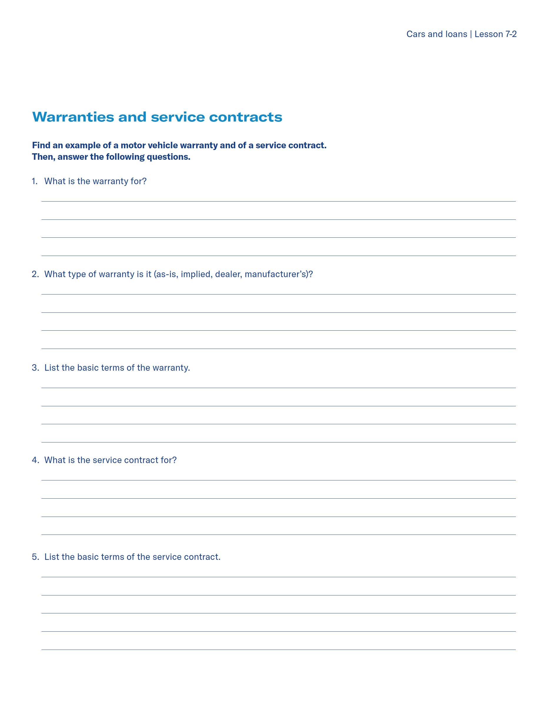
Cars and loans — lesson 7 exercise
Lesson 7
Cars and
loans
Option 2
activity
Depending on how much time there is to complete the lesson, you may select one of the following worksheet exercises for the students to complete.
Worksheet 7-2: Find an example of a motor vehicle warranty and service contract. Then, answer the following questions on the worksheet.
Notes:
Notes to presenter:
Warranties and Service Contracts
■ Have students collect examples of automobile warranties and service contracts.
■ Discuss how various warranties and service contracts differ.

Slide 9
Shopping for a car loan
Lesson 7
Cars and
loans
Variable include:
Annual Percentage Rate (APR)
Length of the loan
Monthly payments
Total finance charge
Total to be repaid
Example of how loans can vary: borrowing $8,000 at different rates
APR | Length of loan | Total monthly payment | Total finance charge | To be repaid
10% | 36 months 60 months | $258.14 $169.98 | $1,292.94 $2,198.52 | $9,292.94 $10,198.52
12.25% | 36 months 60 months | $266.67 $178.97 | $1,600.15 $2,738.03 | $9,600.15 $10,738.03
13% | 36 months 60 month | $269.55 $182.02 | $1,703.87 $2,921.58 | $9,703.87 $10,921.58
Notes:
Discuss the concept of shopping for a car loan and the following variables:
1. APR
2. Length of loan
3. Monthly payments
4. Total finance charge
5. Total to be repaid
6. Shop around for a car loan and compare the costs

Slide 10
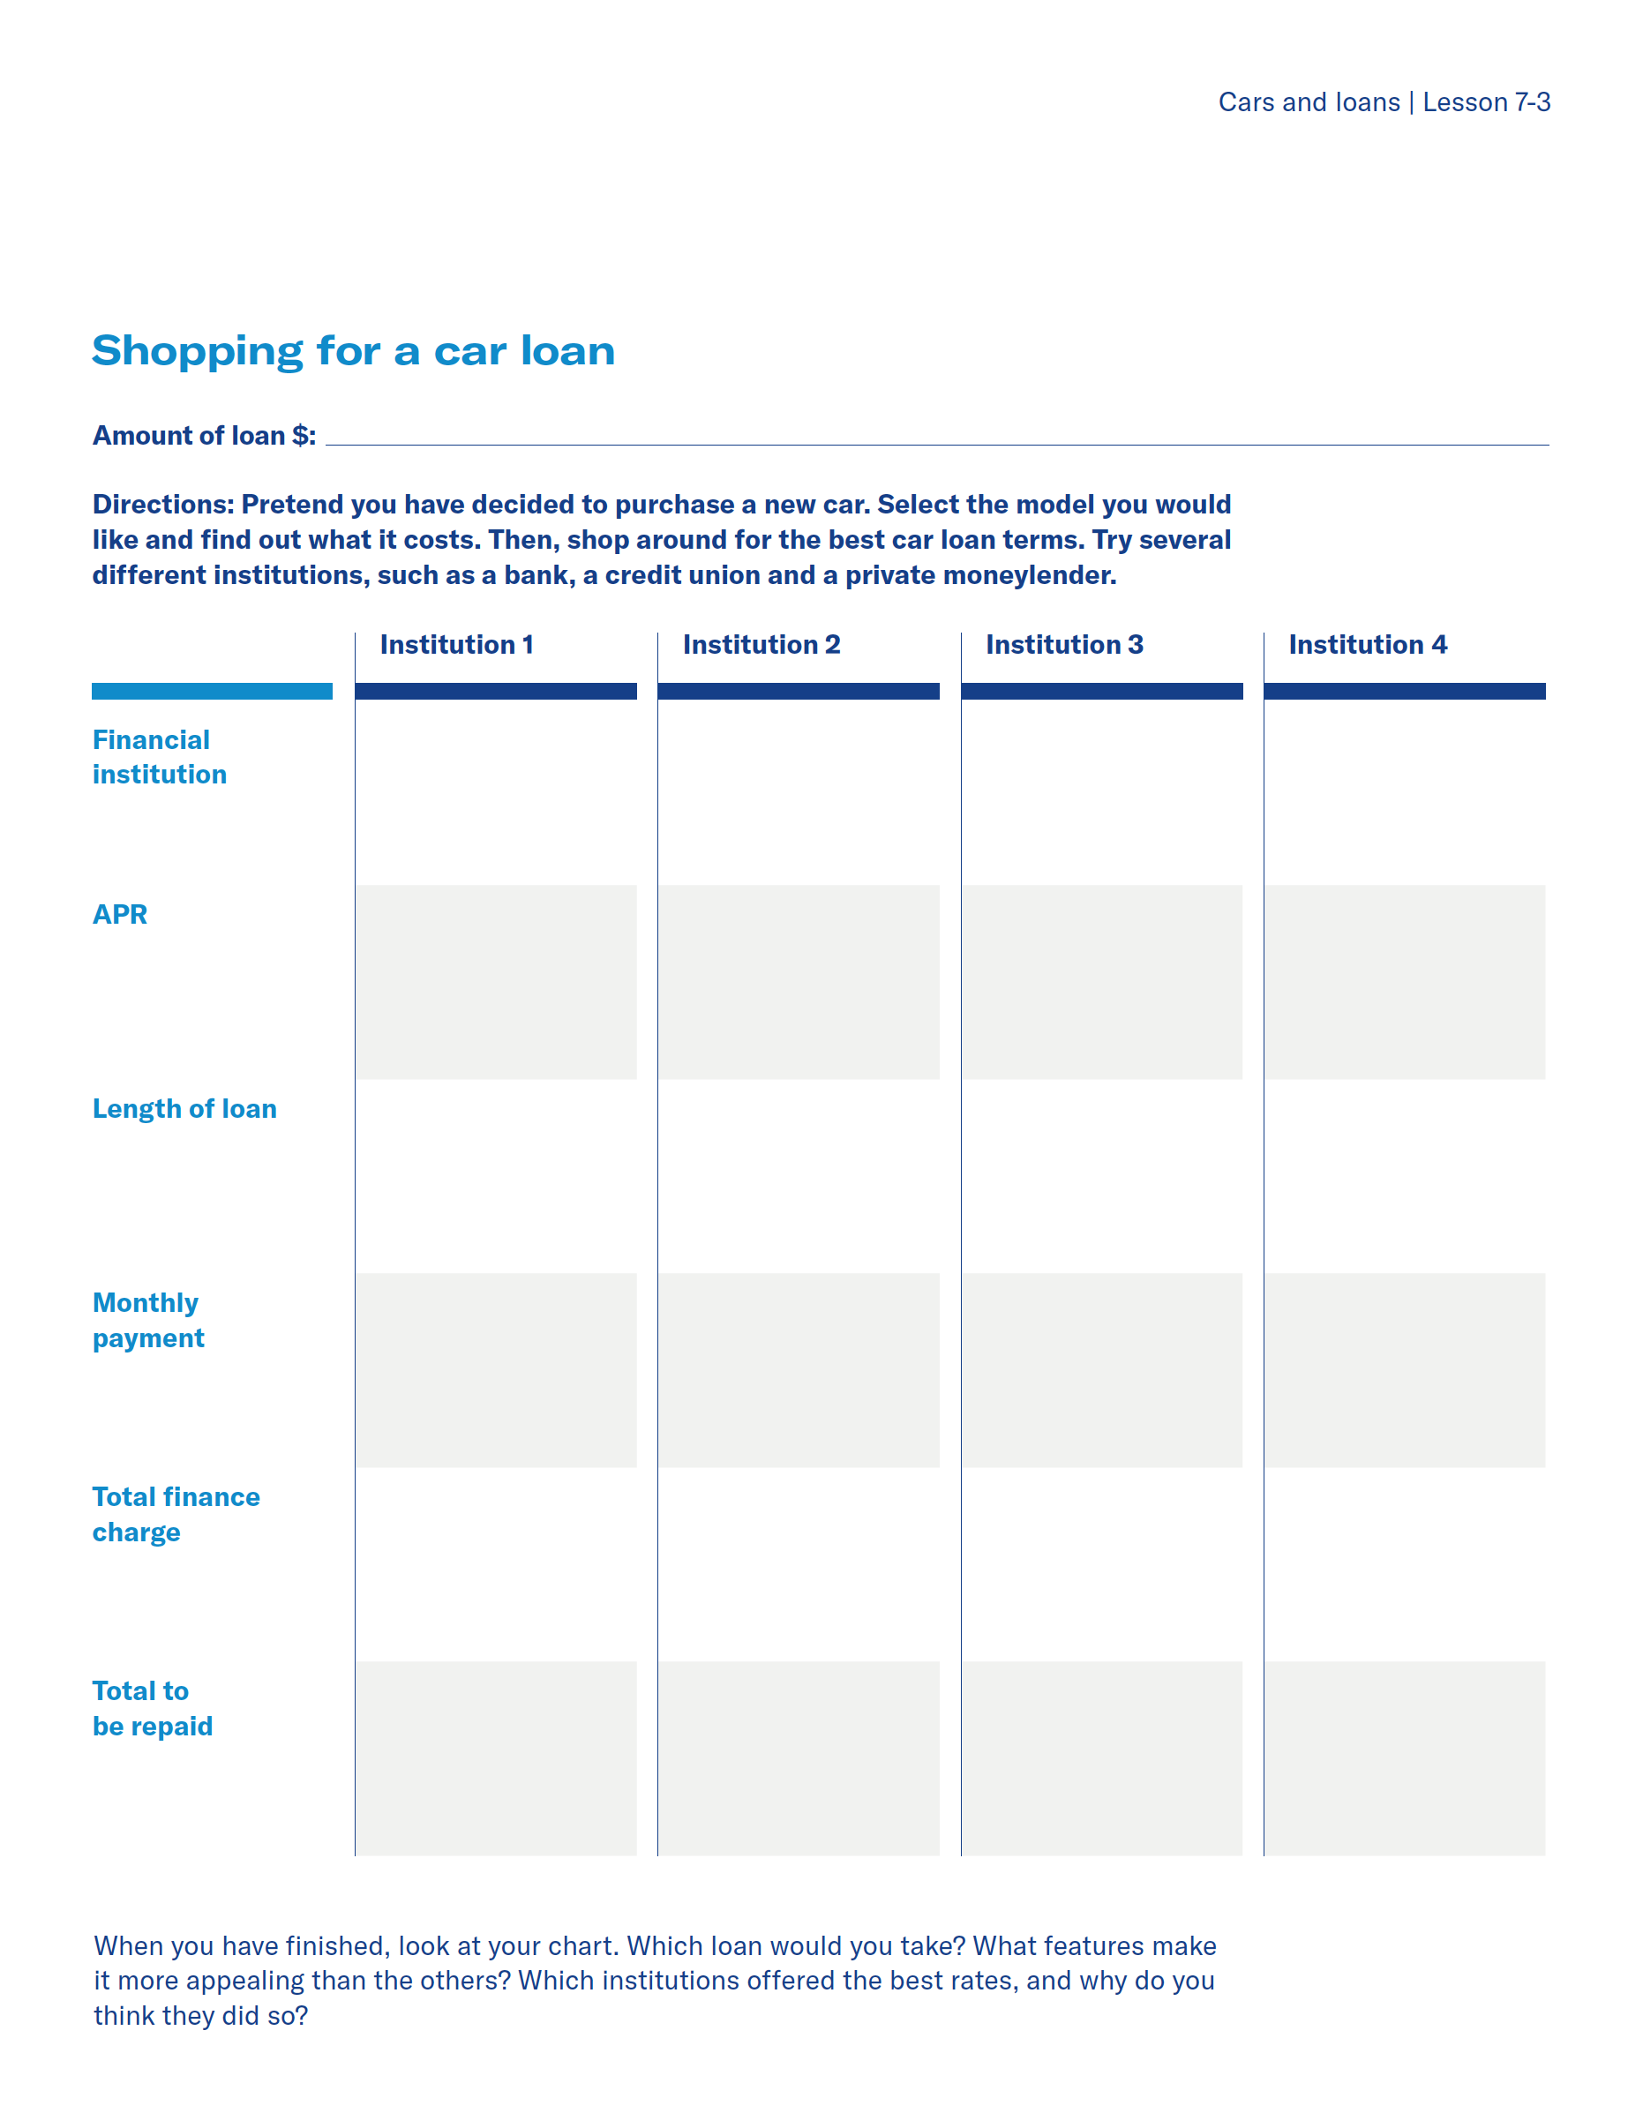
Cars and loans — lesson 7 exercise
Lesson 7
Cars and
loans
Option 3
activity
Depending on how much time there is to complete the lesson, you may select one of the following worksheet exercises for the students to complete.
Worksheet 7-3: Pretend you have decided to purchase a new car. Select the model you would like and find out what it costs. Then, shop around for the best car loan terms. Try several different institutions, such as a bank, a credit union and a private moneylender.
When you have finished, look at your chart. Which loan would you take? What features make it more appealing than the others? Which institutions offered the best rates, and why do you think they did so?
Notes:
Notes to presenter:
Warranties and Service Contracts
■ Have students collect examples of automobile warranties and service contracts.
■ Discuss how various warranties and service contracts differ.

Slide 11
Lesson 7
How to calculate the total cost of a loan
Cars and
loans
To estimate the total cost of a loan:
To estimate the amount of monthly payments:
Amount of the loan x APR x number of years¹
Total to be paid divided by number of months of the loan¹
Example:
$10,000 x 0.10 x 5 years = $5,000
Example:
$15,000/60 = $250 per month
1 These formulas produce estimates are slightly higher than your actual costs and payments because they do not account for the reduction of interest payments as you repay the loan.
Notes:
How much does it really cost?
Discuss how to approximate the total cost of a loan
Discuss how to approximate monthly payments
do you need a loan co-signer?
1. What a co-signer is
2. When you need one
3. Responsibilities
■ Yours
■ Co-signer’s

Slide 12
Lesson 7
Types of auto insurance coverage
Cars and
loans
Liability (40%–50% of premium) | Bodily injury coverage Property damage coverage (e.g., to another person’s car)
Collision (up to 30% of premium) | Pays for the physical damage to your car as a result of an accident Limited by deductible
Comprehensive (about 12% of premium) | Pays for damage caused by vandalism, hailstorms, floods, theft, etc.
Medical | Covers medical payments for driver and passengers injured in accident
Uninsured motorist | Reimburses you for bodily injury in accidents caused by uninsured drivers
Towing and labor | Optional coverage that protects against some of the costs and hassles associated with common roadside breakdowns
Rental reimbursement | Pays a specific amount per day to rent a car while yours is being fixed
Notes:
about auto insurance
1. Importance of and legal requirements
2. Types of coverage
■ Bodily injury liability
■ Property damage liability
■ Collision
■ Comprehensive
■ Medical payments
■ Uninsured motorist
■ Rental reimbursement
■ Towing and labor

Slide 13
Lesson 7
How insurance rates are set
Cars and
loans
Personal characteristics
Driving record
Age
Sex
Marital status
Personal habits (e.g., smoking)
Type and frequency of vehicle use (e.g., commuting)
Accident with death, bodily injury or property damage in excess of $400 may trigger surcharge on premium for 3 years
Number and kind of moving violations (and total of associated points)
Number of years insured with the company
Geographic location (often classified by ZIP code)
Vehicle characteristics
Rural usually lowers rates, urban usually raises rates
Damage, repair and theft record of type and model of car
Age of car
Notes:
How insurance rates are set
■ Age
■ Sex
■ Marital status
■ Personal habits (e.g., smoking)
■ Type of use
■ Frequency of use
■ Location
■ Driving record deductible
■ Type of car
■ Value and age of car

Slide 14
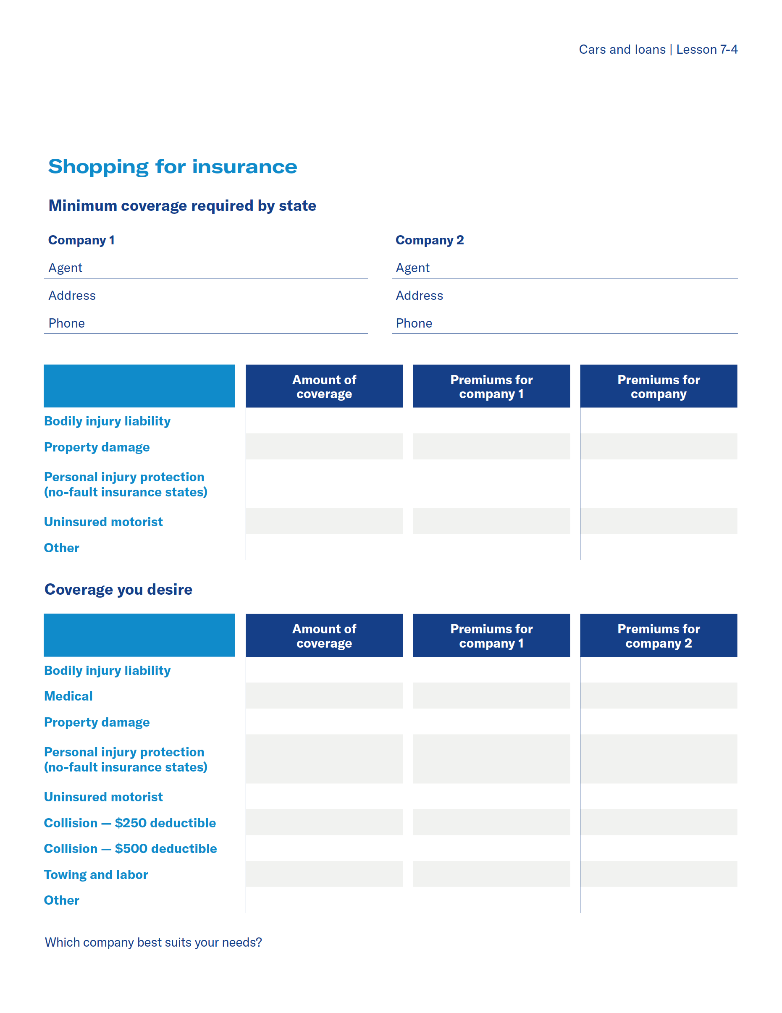
Cars and loans — lesson 7 exercise
Lesson 7
Cars and
loans
Option 4
activity
Depending on how much time there is to complete the lesson, you may select one of the following worksheet exercises for the students to complete.
Worksheet 7-4: Choose two insurance companies to research that offer auto insurance. Complete the worksheet based on your age, gender, marital status, frequency of car use, where you live, driving record, type of car you want and the amount of insurance you think you need.
Discuss which insurance company best suits your needs.
Notes:
Notes to presenter:
Shopping for Insurance
■ Have students research the cost of car insurance based on their age, gender, marital status, frequency of car use, where they live, driving record, types of cars they want,
and the amount of insurance they think they need vs. what may be required by the state.
■ Discuss their findings—would the cost of insurance alter their budgets or change
their plans about the types of cars they want? Can they still afford cars?
*Goal for this activity is for students to understand the types of coverage, insurance based on car type, and cost factors.

Slide 15
Cars and loans — lesson 7 exercise
Lesson 7
Cars and
loans
Option 5
activity
Depending on how much time there is to complete the lesson, you may select one of the following worksheet exercises for the students to complete.
Worksheet 7-5: How much would you spend?
Use the attached budget sheet (practicalmoneyskills.com) and loan calculator to complete the following chart and answer the questions in the worksheet.
Notes:
Notes to presenter:
How Much Would You Spend
■ Using the scenarios provided, have students decide how much can be spent safely each month to own, operate, and maintain a car.
Discussion points: how much would you spend?
1. Cost of driving off lot
■ Down payment
■ Tax
■ License
■ Other
2. Car payment
3. Monthly operating costs
4. Monthly maintenance costs
5. Monthly insurance premium
6. Unplanned maintenance and operating costs

Slide 16
Lesson 7
Leasing a car
Cars and
loans
Advantages
Disadvantages
Discussion of leasing vs. buying
Smaller initial outlay than down payment when buying on credit
Monthly lease payments may be less than monthly finance payments
Lease agreement provides detailed records for business purposes
Oftentimes, all service charges related to maintenance are included in lease, so there is no additional outlay of money for regular maintenance
No ownership interest in the vehicle
Must meet requirements similar to applying for credit
Additional costs occur (such as for extra mileage, certain repairs, ending lease early)
You must decide which option makes the most sense for your situation.
Do you have cash available for a down payment?
How much of a monthly payment can you afford?
How long do you plan to keep the car?

Slide 17
Lesson 7
Cars and
loans
Lesson 7 quiz

Slide 18
Lesson 7
Lesson 7 quiz
Cars and
loans
F
T
T
F
F
Notes:
If there is time, allow students to complete the quiz, then review the answers with them. Answers are featured in slide slow mode with each click.

Slide 19
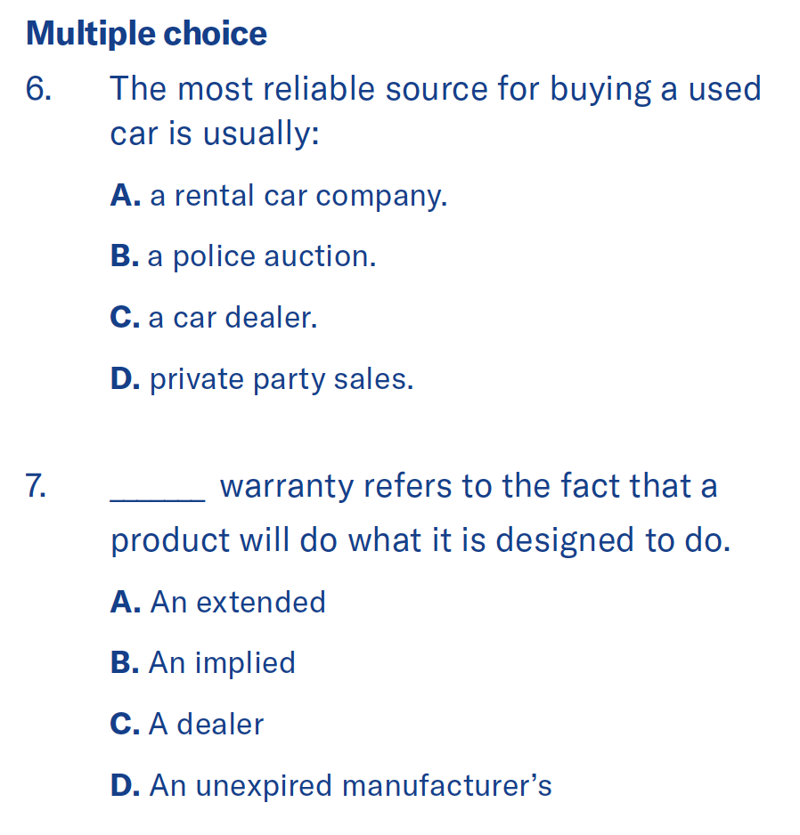
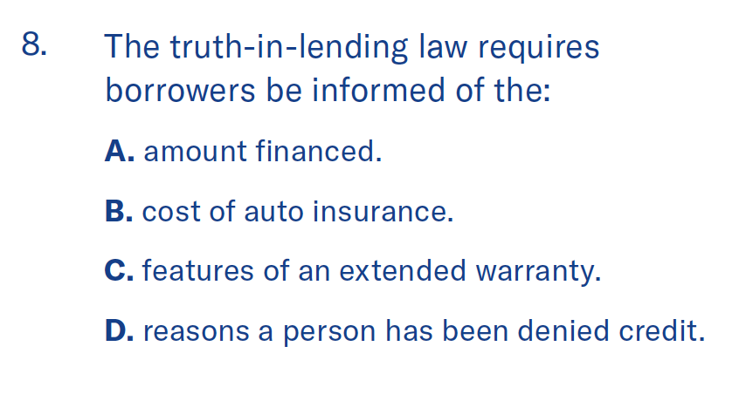
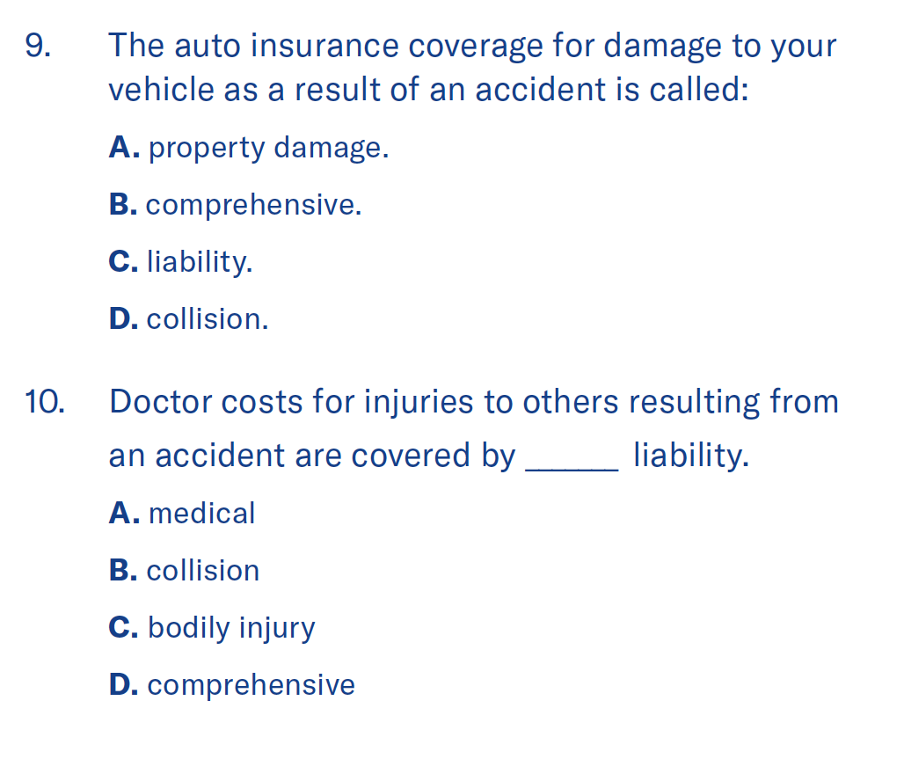
Lesson 7
Lesson 7 quiz
Cars and
loans
C
A
D
B
C
Notes:
If there is time, allow students to complete the quiz, then review the answers with them. Answers are featured in slide slow mode with each click.

Slide 20
Lesson 7
Lesson 7 quiz
Cars and
loans
Many factors go into this decision. First, Angelina must consider her financial situation. Based on a realistic budget, what amount can she afford to spend for buying a different vehicle? Next, will her current car (after the recent repairs) give her reliable transportation? In addition, how do the expected operating costs of the various vehicles compare?
Notes:
If there is time, allow students to complete the quiz, then review the answers with them. Answers are featured in slide slow mode with each click.

Slide 21
Important information
Equitable is the brand name of the retirement and protection subsidiaries of Equitable Holdings, Inc., including Equitable Financial Life Insurance Company (NY, NY); Equitable Financial Life Insurance Company of America, an AZ stock company; and Equitable Distributors, LLC. Equitable Advisors is the brand name of Equitable Advisors, LLC (member FINRA, SIPC) (Equitable Financial Advisors in MI & TN). The obligations of Equitable Financial and Equitable America are backed solely by their claims-paying abilities.
© 2023 Equitable Holdings, Inc. All rights reserved. GE-5492583.1 (3/23) (Exp. 3/25) | G2090361 | Cat. #162163 (3/23)

Slide 23
Thank you.
Notes:
Read Slide

