Slide 1



Lesson 4
Banking
services
Speaker/team/other
Month 00, 2022

Slide 2




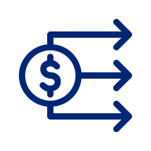


The cost of financial services
Lesson 4
Banking
services
Pawn shops
Rent-to-own programs
  Charge very high interest for loans based on the value of tangible assets (such as jewelry or other valuable items).
  Offer an opportunity to obtain home entertainment systems or appliances for a small weekly fee. However, the amount paid for the item usually far exceeds the cost if the item were bought on credit.
Check cashing outlets
Rapid refund tax services
  Charge high fees (sometimes 2% or 3%) just to have a paycheck or government check cashed.
  Provide instant refunds when you pay
  to have your federal tax return prepared. However, this instant refund is a loan with interest rates as high as 120%.
Check-deferral services
  Allow consumers to get a cash advance on their next paycheck. However, these short-term loans are very expensive.
  A $200, 2-week advance may cost over $30 (with annual costs exceeding $900).
Banking services — Month 00, 2022
Notes:
Review the slide content as concepts that may seem like an incentive but in reality can cost the consumer more money over time.

Slide 3





Lesson 4
Compare options for checking accounts
Banking
services
Location
Fees
Other charges
Branch offices; hours of operation; availability of ATMs
Monthly fees; per check fees; printing of checks; balance inquiry fees; ATM fees
Overdraft charge; stop-payment fees; certified check fees
Interest
Restrictions
Special features
Rate earned; minimum deposit to earn interest; compounding method; fee charged for falling below necessary balance
Minimum balance; deposit insurance; holding period for deposited checks
Direct deposit; automatic payments; overdraft protection; online banking; discounts or free checking for students, seniors or employees of certain companies
Banking services — Month 00, 2022
Notes:
Discuss things to consider when choosing a checking account:
1. Monthly fees
2. Per-check charges
3. Balance requirements
4. Interest rate
5. How rates are calculated
6. How soon you can draw against a deposit
7. Bounced check charges
■ On your check
■ On a check you deposited
8. ATM charges
9. Debit card charge
10. Stop payment fees
11. Charges for printed checks
12. Locations/number of branches
13. Bank hours
14. Online banking option
15. Bill pay option

Slide 4
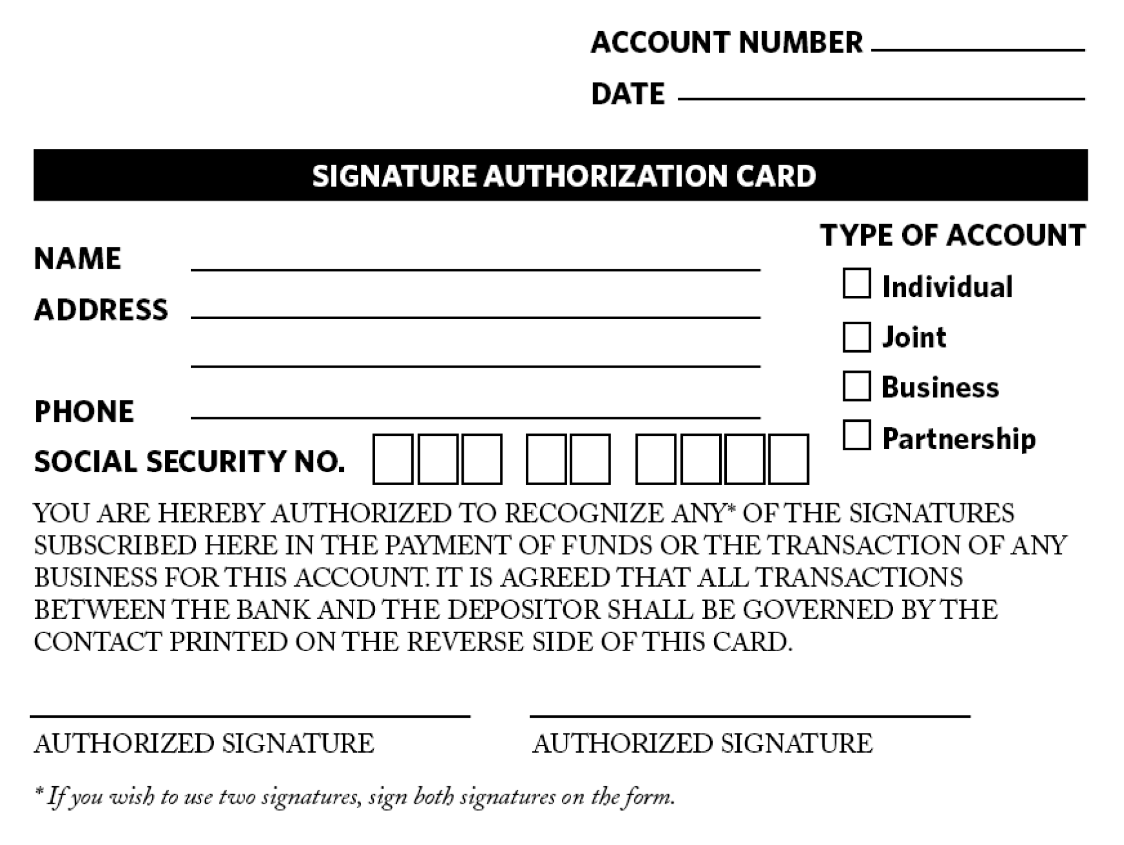
Opening a checking account
Lesson 4
Banking
services
Banking services — Month 00, 2022
Notes:
Discuss the following topics regarding opening a checking account:
1. Signature authorization card
2. The contract and what it means
3. Initial deposit

Slide 5
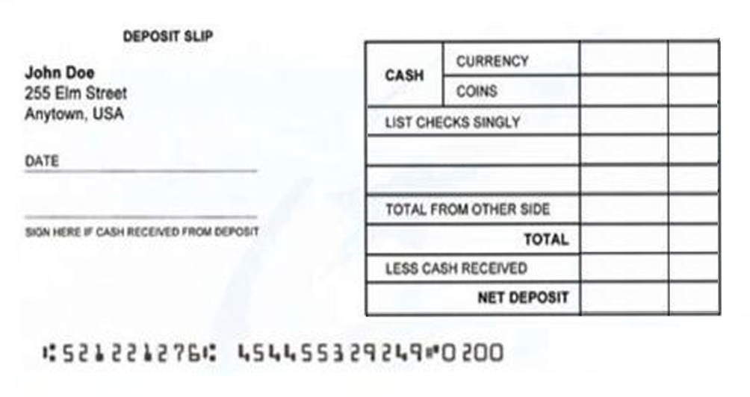
Making a deposit
Lesson 4
Banking
services
2
If you are depositing currency (paper bills), write the total amount here.
DEPOSIT SLIP
John Doe
255 Elm Street
Anytown, USA
CASH
CURRENCY
3
COINS
If you are depositing coins, write the total amount here.
LIST CHECKS SINGLY
5
1
Write the amount of the check here.
Write the date of the deposit
in this field.
DATE
TOTAL FROM OTHER SIDE
6
If you are depositing more checks than can be listed on the front, continue to list them on the back, and write the total amount of the checks on back here.
If you are depositing a check, write the bank transit number here, which is the top portion of the two-part number printed in the upper corner of the check.
4
SIGN HERE IF CASH RECEIVED FROM DEPOSIT
TOTAL
LESS CASH RECEIVED
NET DEPOSIT
7
Write the total amount you are depositing here.
9
Write the total amount (less cash back) of your deposit in this field.
8
If you are making a deposit inside a bank with a teller and you want to receive cash back from your deposit, write the amount you want in this field.
Banking services — Month 00, 2022
Notes:
Review steps in filling out a deposit slip

Slide 6
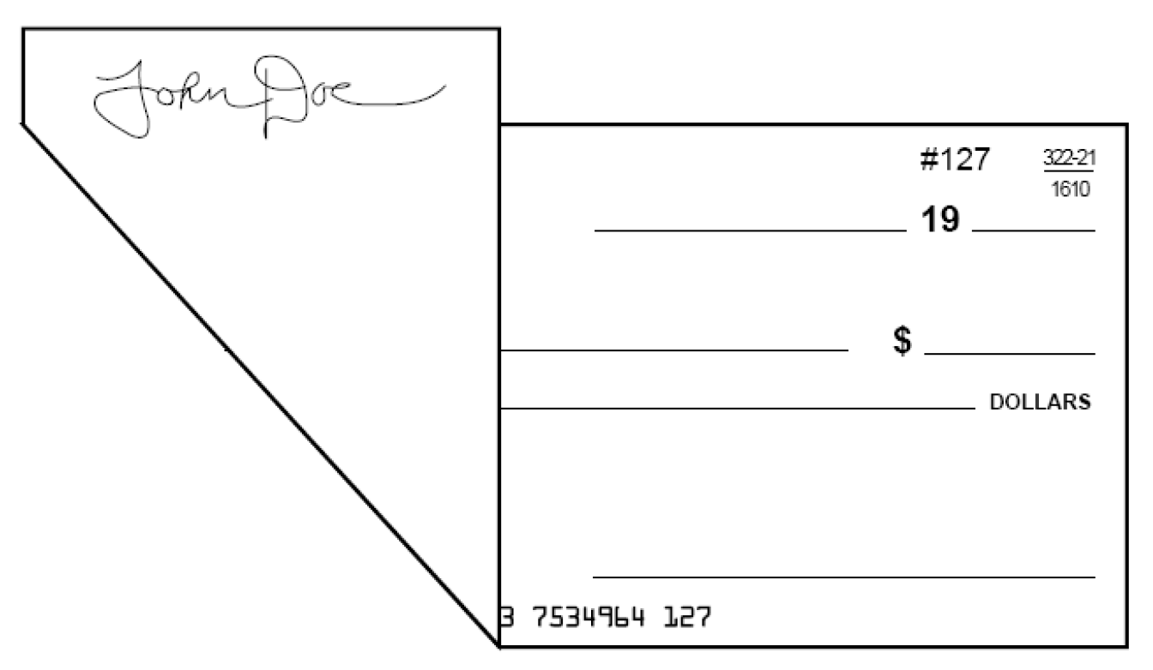
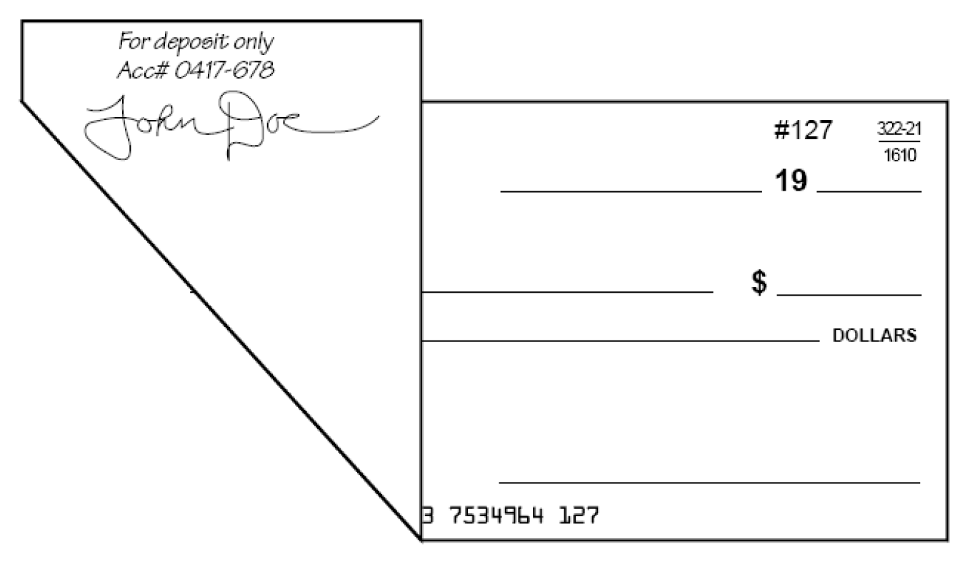
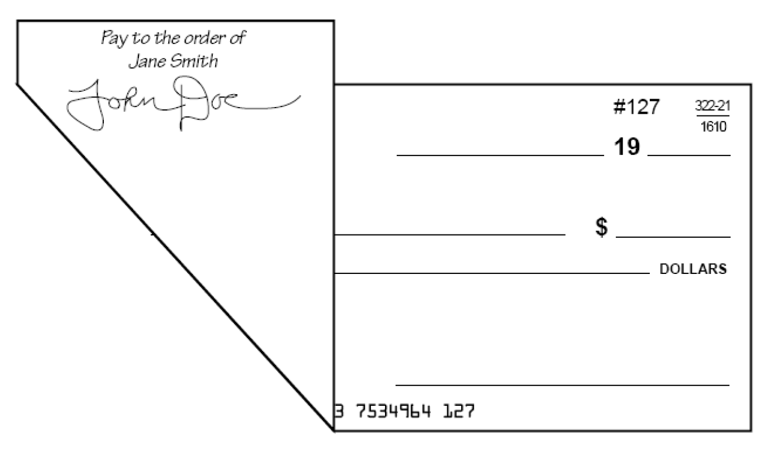
Endorsing a check
Lesson 4
Banking
services
Blank endorsement:
anyone can cash check
Restrictive endorsement:
more secure than blank endorsement
Special (or full) endorsement: transfer check to another party
Banking services — Month 00, 2022
Notes:
Review steps to correctly endorse/fill out a check.
Then discuss options for depositing a check:
Direct deposit
Manual deposit

Slide 7
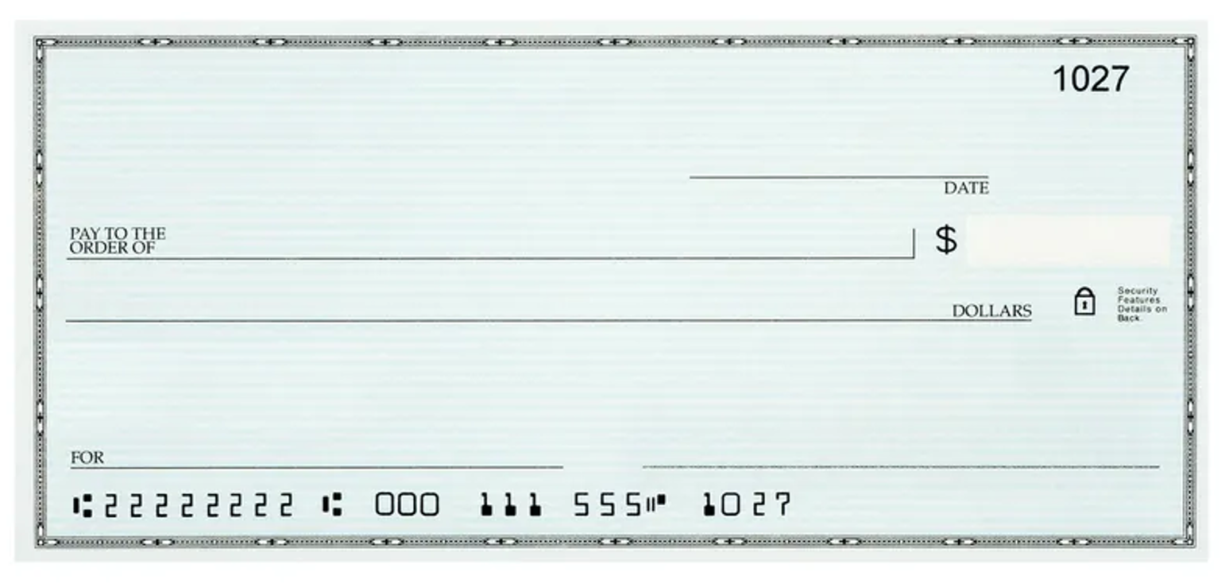
Writing a check
Lesson 4
Banking
services
Name Your personal information is printed here. Never list your Social Security number on your printed check.
5
John Doe
255 Elm Street
Anytown, USA
1
Date Enter the date on which you are writing the check.
Payee Enter the name of the person or the company you
are going to give the check to.
2
3
Amount of check in numerals Enter the amount of the check in numbers. Don’t leave any space between the pre-printed dollar symbol ($) and the numbers indicating the amount of the check; there should be no room for someone to add in extra numbers.
Amount of check in words Enter the amount of the check in words. Start writing at the far left side of the line. Follow the dollar amount by the word “and,” then write the amount of cents over the number 100. Draw a line from the end of
the 100 to the end of the line.
4
6
Signature Sign your check exactly
the way you signed your name on
the signature card you filled out
when you opened your account.
7
8
Memo Use this space to note why you wrote the check. If you are paying
a bill, this is a good place to put information requested by the company, like your account number.
Identification numbers These numbers are used to identify the bank, your account number and the check number. They are printed in a special magnetic ink that machines can read.
Banking services — Month 00, 2022
Notes:
Review steps to correctly endorse/fill out a check. (slides 8-10)
Then discuss options for depositing a check:
Direct deposit
Manual deposit

Slide 8
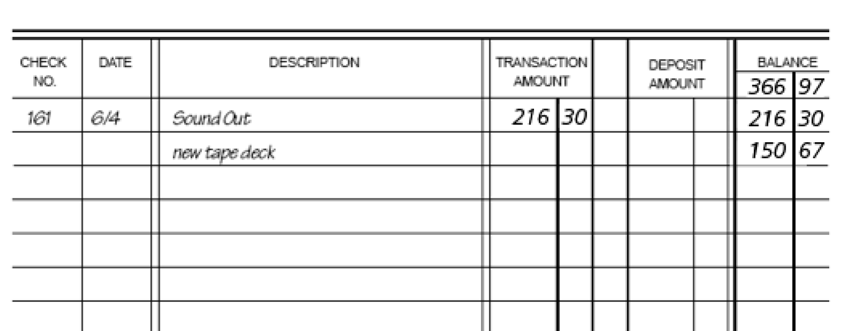
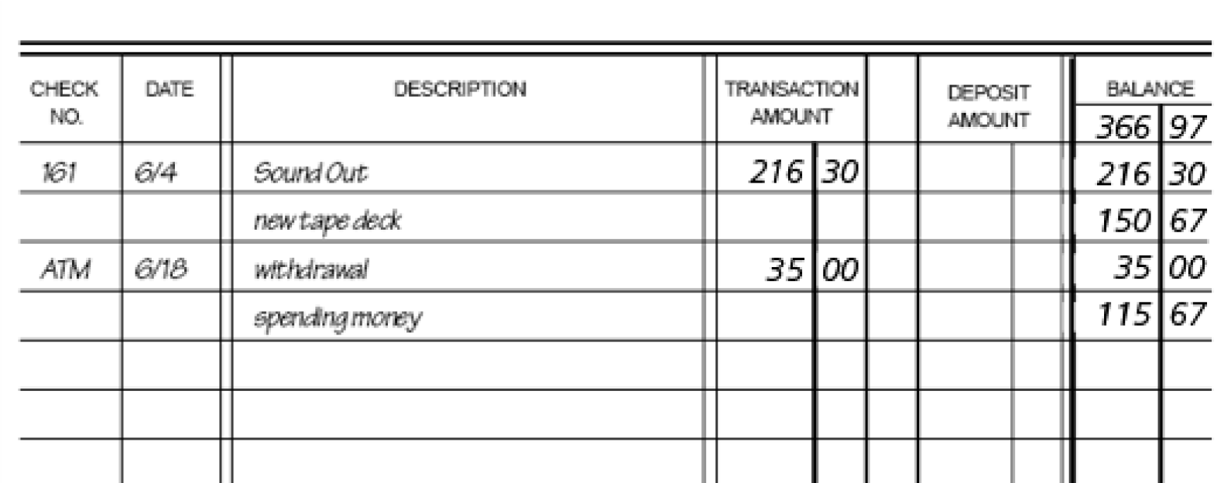
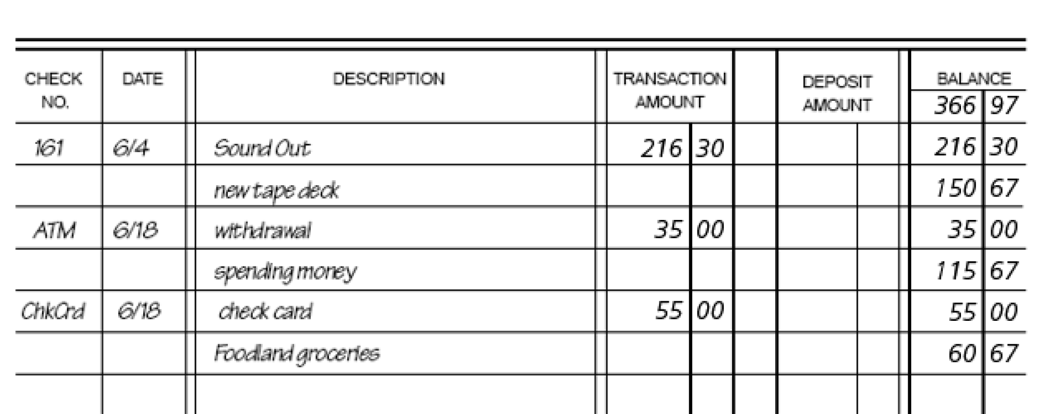
Keeping a running balance
Lesson 4
Banking
services
Check transaction
ATM cards
Check cards
Banking services — Month 00, 2022
Notes:
After discussing out to write a check, review the concept of keeping a running balance with check transactions, ATM cards, and check cards (image on next slide
Writing a check
Entering information about a check in your check register
Keeping a running balance in your check register
If there is time you can discuss ATM/debit (check) cards in more detail:
What is an ATM/Debit card
What does an ATM/Debit card look like
Advantages/disadvantages of using it
How to use it at the ATM
Difference from a credit card
What it replaces (cash/paper check)
Option to incorporate this discussion into student activity 6-2

Slide 9
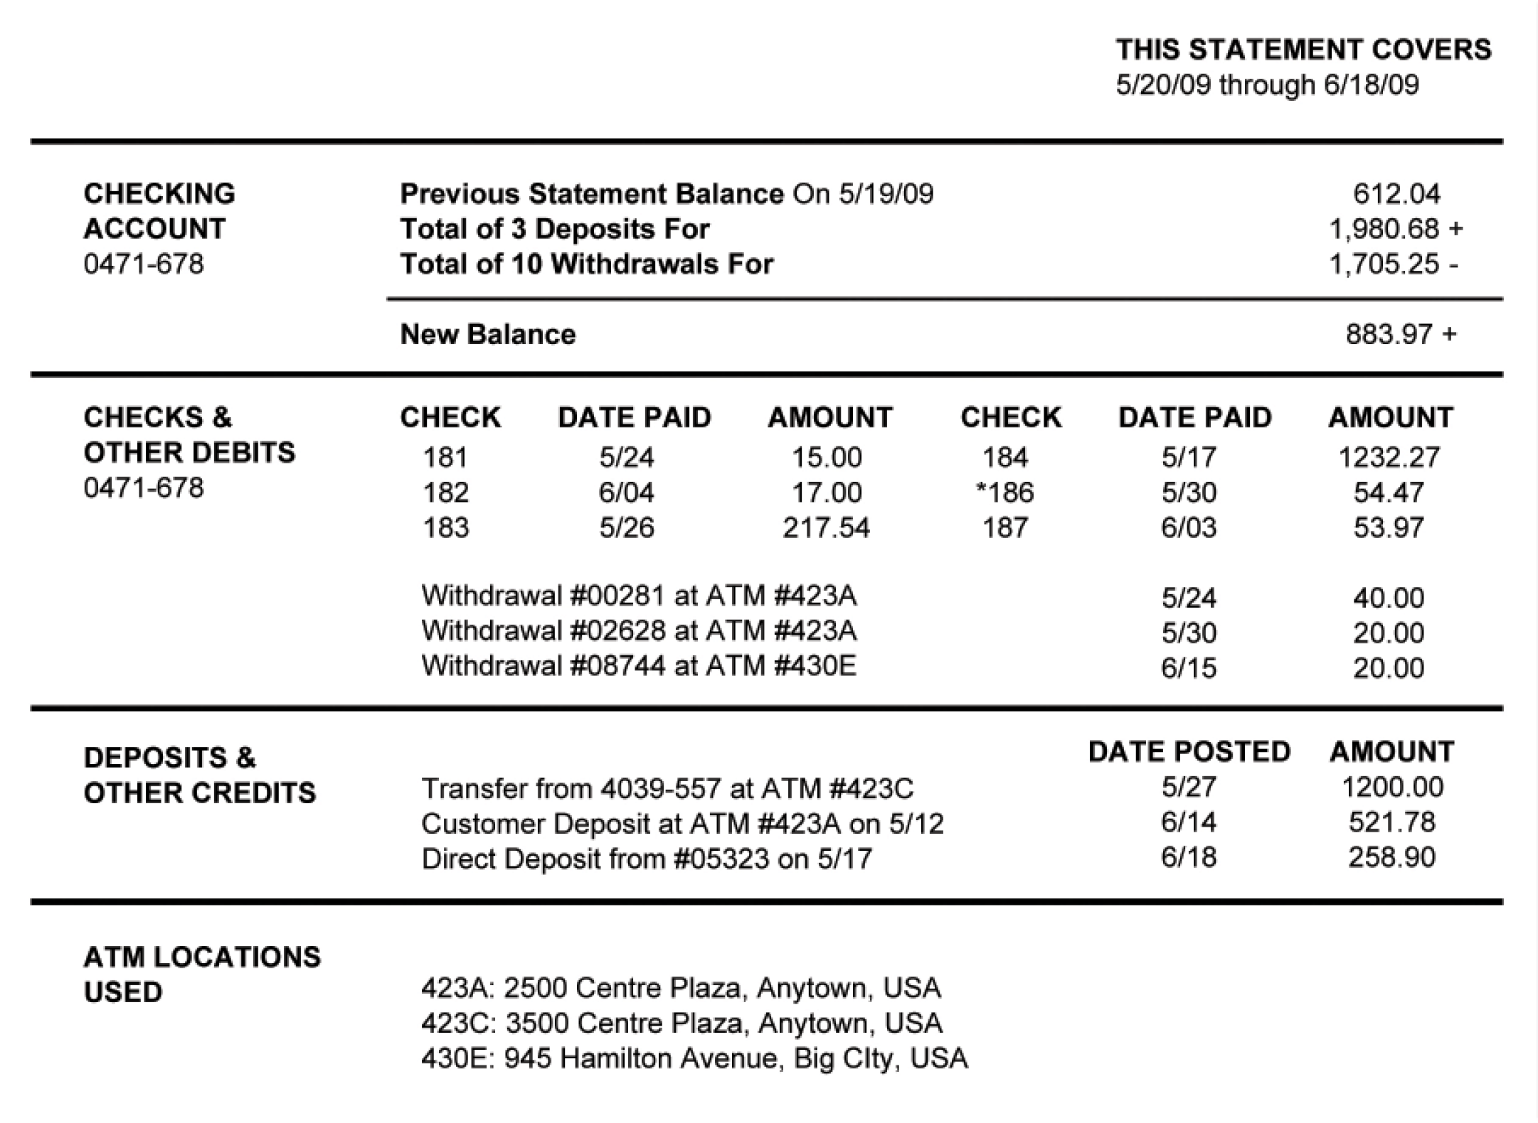
Reading a bank statement
Lesson 4
Banking
services
Banking services — Month 00, 2022
Notes:
Interpreting a bank statement and
reconciling an account
1. Reading a bank statement
2. Reconciling an account
■ Checking the bank statement
■ Verifying checks in the check register
■ Verifying deposits and ATM transactions
■ Verifying debit card transactions
■ Correcting entry errors in the check register
■ Correcting deposit or ATM transaction amounts
in the check register
■ Correcting debit card transaction amounts in the
check register
■ Correcting errors of omission in the check register
■ Finding outstanding transactions
3. Practice reading a bank statement
4. Practice reconciling an account

Slide 10
Reconciling a checking account
Lesson 4
Banking
services
1
2
3
4
Step
Step
Step
Step
Obtain the current balance from your bank statement.
Add any deposits you have recorded in your check register, but are not on this statement.
Subtract any outstanding checks (checks you have written but have not yet cleared the banking system).
Compare the result with the current balance
in your check register.
Banking services — Month 00, 2022

Slide 11






Electronic banking services
Lesson 4
Banking
services
Direct deposit
Point-of-sale transactions
Electronic cash
Earnings (or government payments) automatically deposited into bank accounts, saving time, effort and money.
Acceptance of ATM/debit card at retail stores and restaurants for payment of goods and services.
Companies are developing electronic replicas of all existing payment systems — cash, check, credit cards and coins.
Automatic payments
Stored-value cards
Online banking
Utility companies, loan payments and other businesses use an automatic payment system with bills paid through direct withdrawal from a bank account.
Prepaid cards for telephone service, transit fares, highway tolls, laundry service, library fees and school lunches.
Banking through online services. Bank websites allow customers to check balances, pay bills, transfer funds, compare savings plans and apply for loans online.
Automatic teller machines (ATM)
Allow customers to obtain cash and conduct banking transactions; some ATMs sell bus passes, postage stamps, gift certificates and mutual funds.
Banking services — Month 00, 2022
Notes:
Review these electronic banking terms that will be important for students to comprehend.

Slide 12


Lesson 4
Banking
services
Lesson 4 quiz
Banking services — Month 00, 2022

Slide 13
Lesson 4 quiz
Lesson 4
Banking
services
True/False
1. |  | A pawn shop offers loans to people starting their own business.
2. |  | Opening a checking account requires completing a signature card.
3. |  | A blank endorsement allows anyone to cash a check.
4. |  | A smart card stores a person’s bank balance right on the plastic card.
5. |  | An outstanding check refers to one written on an account with a very low balance.
F
T
T
T
F
Multiple choice
6. |  | The highest loan rates usually occur
 |  | when borrowing from a:
 |  | A. Bank B. Credit card company C. Pawn shop D. Credit union
7. |  |  | A |  | is used to add funds to a bank account.
 |  |  | A. Check B. Deposit slip C. Signature card D. Withdrawal slip
C
B
Banking services — Month 00, 2022
Notes:
If there is time, allow students to complete the quiz, then review the answers with them. Answers are featured in slide slow mode with each click.

Slide 14
Lesson 4 quiz
Lesson 4
Banking
services
Multiple choice
8. |  | Obtaining cash from an ATM is similar to:
 |  | A. Writing a check B. Making a deposit C. Opening a new account D. Earning interest on your account
9. |  | A service charge on your bank
 |  | statement will result in:
 |  | A. A higher balance B. A lower balance C. Earning more interest D. More outstanding checks
A
B
Banking services — Month 00, 2022
Notes:
If there is time, allow students to complete the quiz, then review the answers with them. Answers are featured in slide slow mode with each click.

Slide 15


Lesson 4 quiz
Lesson 4
Banking
services
A recent bank statement for Tracy Gray revealed various service charges and fees of over $10. How might Tracy reduce her costs for banking fees?
Tracy should start by analyzing her financial services habits. For example, if she uses an ATM often, the fees could be high. Or, if her checking account gets too low or drops below zero, she may have to pay a monthly fee or other charges for overdrawn accounts. If her fees are still high after careful use of banking services, she should compare the costs at other banks or a credit union and consider moving her account.
Banking services — Month 00, 2022
Notes:
If there is time, allow students to complete the quiz, then review the answers with them. Answers are featured in slide slow mode with each click.

Slide 16
Important information
Equitable is the brand name of the retirement and protection subsidiaries of Equitable Holdings, Inc., including Equitable Financial Life Insurance Company (Equitable Financial) (NY, NY); Equitable Financial Life Insurance Company of America (Equitable America), an AZ stock company with main administrative headquarters in Jersey City, NJ; and Equitable Distributors, LLC. Equitable Advisors is the brand name of Equitable Advisors, LLC (member FINRA, SIPC) (Equitable Financial Advisors in MI & TN).
© 2022 Equitable Holdings, Inc. All rights reserved. GE-4762991.1 (5/22) (Exp. 5/24) | G1745128
Banking services — Month 00, 2022

Slide 17


Slide 18
Thank you.

